Slide 1
EELISA ACTIVITY
Workshop Museum of Mathematics
Date: Oct, 1, 2022 – April, 30, 2023
Organized by: Mariló López González
Sponsors/other stakeholders:
Location: ETSI Caminos, Canales y Puertos, UPM
Format: Hybrid

Slide 2
Description of the activity
ACTIVITY IN NUMBERS
# inscriptions: hundreds of high school students each month
# participants: 2 UPM Students + 2 faculty # badges: 2
# ECTS: 1 (at UPM)
# Communities involved: 1
# mobilities: -
Universities involved:
UPM
Collaboration in the Workshop Museum of Mathematics. Since 2014, this space has becomed a cultural center for the educational community and the general public, where different activities are carried out, such as:
exhibitions connecting to Mathematics with many fields as plastic arts, literature, cinema, etc.
mathematical workshops aimed at audiences of all ages with special attention to children.
conferences and events related to Mathematics.
In this EELISA activity, University students collaborate with faculty in the organization and implementation of activities,
SDGs:
Impact:
Level 4
Impact:
Level 3

Slide 3
Results
.
To build bridges between high school and higher education.
To bring high school students closer to the mathematic and engineering fields in connection with many aspects of life.
To foster a creative and critical mindset.
To move towards citizen science.
Assessment method
Faculty providers will assess the students participation in design and development of mathematical activities, as well as in serving the public and organizing events. After evaluation EELISA badges will be issued: Learning outcomes 4-4-5 and 5-3-1.

Slide 4
Lessons learned
What’s work out
Bring high school people closer to the university ecosystem in Engineering
Promotion of STEAM vocations and gender equality.
Fostering teaching and divulgation vocations in University students
What we can improve
Dissemination to attract abroad students (without any type of administrative or academic barriers),
Coordination with other EELISA institutions

Slide 5
Evidences
http://www2.innovacioneducativa.upm.es/museomatematicas/
https://ciencia-ciudadana.es/proyecto-cc/aula-taller-museo-de-las-matematicas-pi-ensa/
https://www.upm.es/UPM/MuseosUPM/matematicas
https://twitter.com/piensamuseomat
https://www.facebook.com/piensamuseomat/

Slide 6
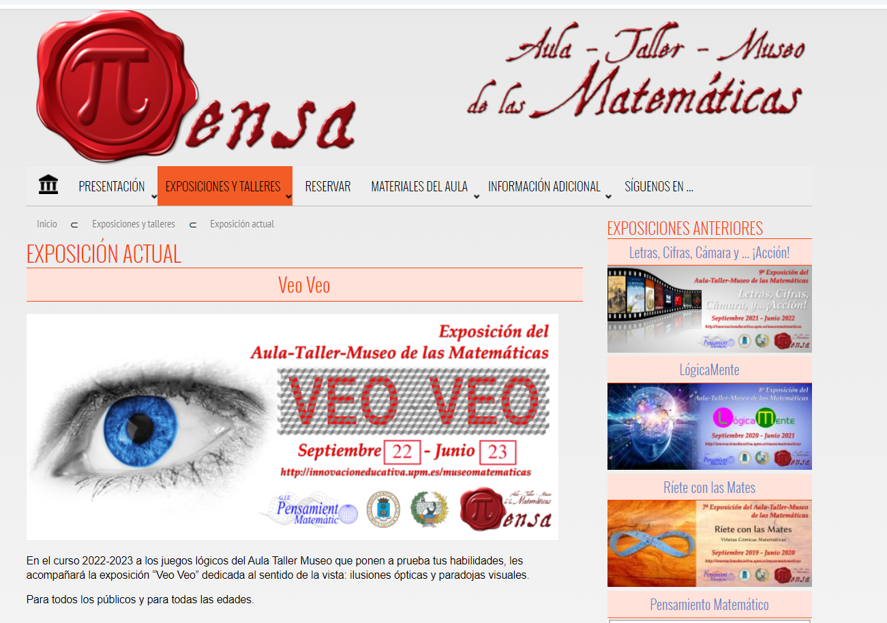
Evidences

Slide 7
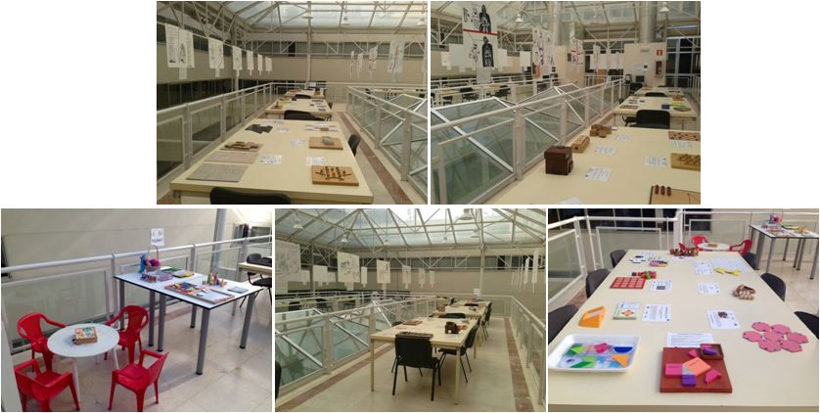
Evidences

Slide 8
Disclaimer
EELISA IS

