Slide 1
EELISA ACTIVITY
Crowdsourcing and Championship against Disinformation
Date: Oct, 1, 2022 – April, 30, 2023
Organized by: María-Jesús Vázquez-Gallo
Sponsors/other stakeholders:
Location: ETSI Caminos, Canales y Puertos, UPM
Format: Hybrid

Slide 2
Description of the activity
ACTIVITY IN NUMBERS
# inscriptions: pending
# participants: until now 25 # badges: 8 (evaluation pending)
# ECTS: -
# Communities involved: 1
# mobilities: -
Universities involved:
UPM, ENPC, FAU, ITU
Disinformation and misinformation have become a complex challenge that negatively affect our society. EELISA people will help to overcome this challenge by participating in this SSERIES activity by any of these two actions:
1) Feeding a database of news linked to sustainability and classified by their verified level of veracity, in a crowdsourcing process through a suitable online form.
2) Participating in an intercampus teams championship against disinformation in person at their own campus and connected online with the rest of the participants. In this debate league the students teams will develop their arguments to convince about the level of veracity of certain news.
There will be an awards ceremony for the winning teams at the championship to be held in Madrid as part of an international “Summathon” that will be a joint SSERIES community event.
SDGs:
Impact 4
Impact 2

Slide 3
Results
.
Expected results are:
Internally, students will reflect about how their individual behavior when sharing news affects global society opinion and they will internalize the need to argue claims and to base them on data and on logical reasoning. Students would feel part of a interdisciplinary and international activity contributing to tackle the social challenge of disinformation.
Externally, this activity should transform people‘s point of view about what reliable information means and it is expected to attract the attention of some mass media stakeholders to EELISA alliance.
Assessment method
1) Regarding crowdsourcing the database of news, activity providers will “curate” the online work of students: each person should look for at least 5 news linked to sustainability and information enough to check their level of veracity, uploading all this through a suitable online form.
2) Regarding participation in international teams championship held synchronously at the EELISA universities involved: students would register themselves in teams of 3 people to participate in a debate league in which they will train logical argumentation and communication strategies to convince about the level of veracity of certain news (taken from the crowdsourced database).
Any of these two actions, previous revision by faculty members, would lead to the issue of two badges with Learning Outcomes 16. Level 2 (knowledge) 4; SDG 4. Level 4 (action) 5.

Slide 4
Lessons learned
What’s work out
Pending of the development of the activity.
What we can improve
After this pilot experience, the activity team will assess its extension to other universities.
As this activity is being developed under the frame of First Joint Call EELISA for inter-institutional activities, it would be useful to improve the allocation of economic resources and their management

Slide 5
Evidences
https://eelisa.eu/23-proposals-selected-under-the-first-eelisa-joint-call-for-inter-institutional-activities/
https://community.eelisa.eu/activities/championship-against-disinformation/
https://ecoledesponts.fr/en/eelisa-european-university?tab=testimonies
https://blogs.upm.es/sseries-eelisa/resultados-de-la-first-eelisa-joint-call-2/
https://blogs.upm.es/sseries-eelisa/are-you-a-well-informed-person/
https://matematicas.epes.upm.es/
https://short.upm.es/ibz0n

Slide 6
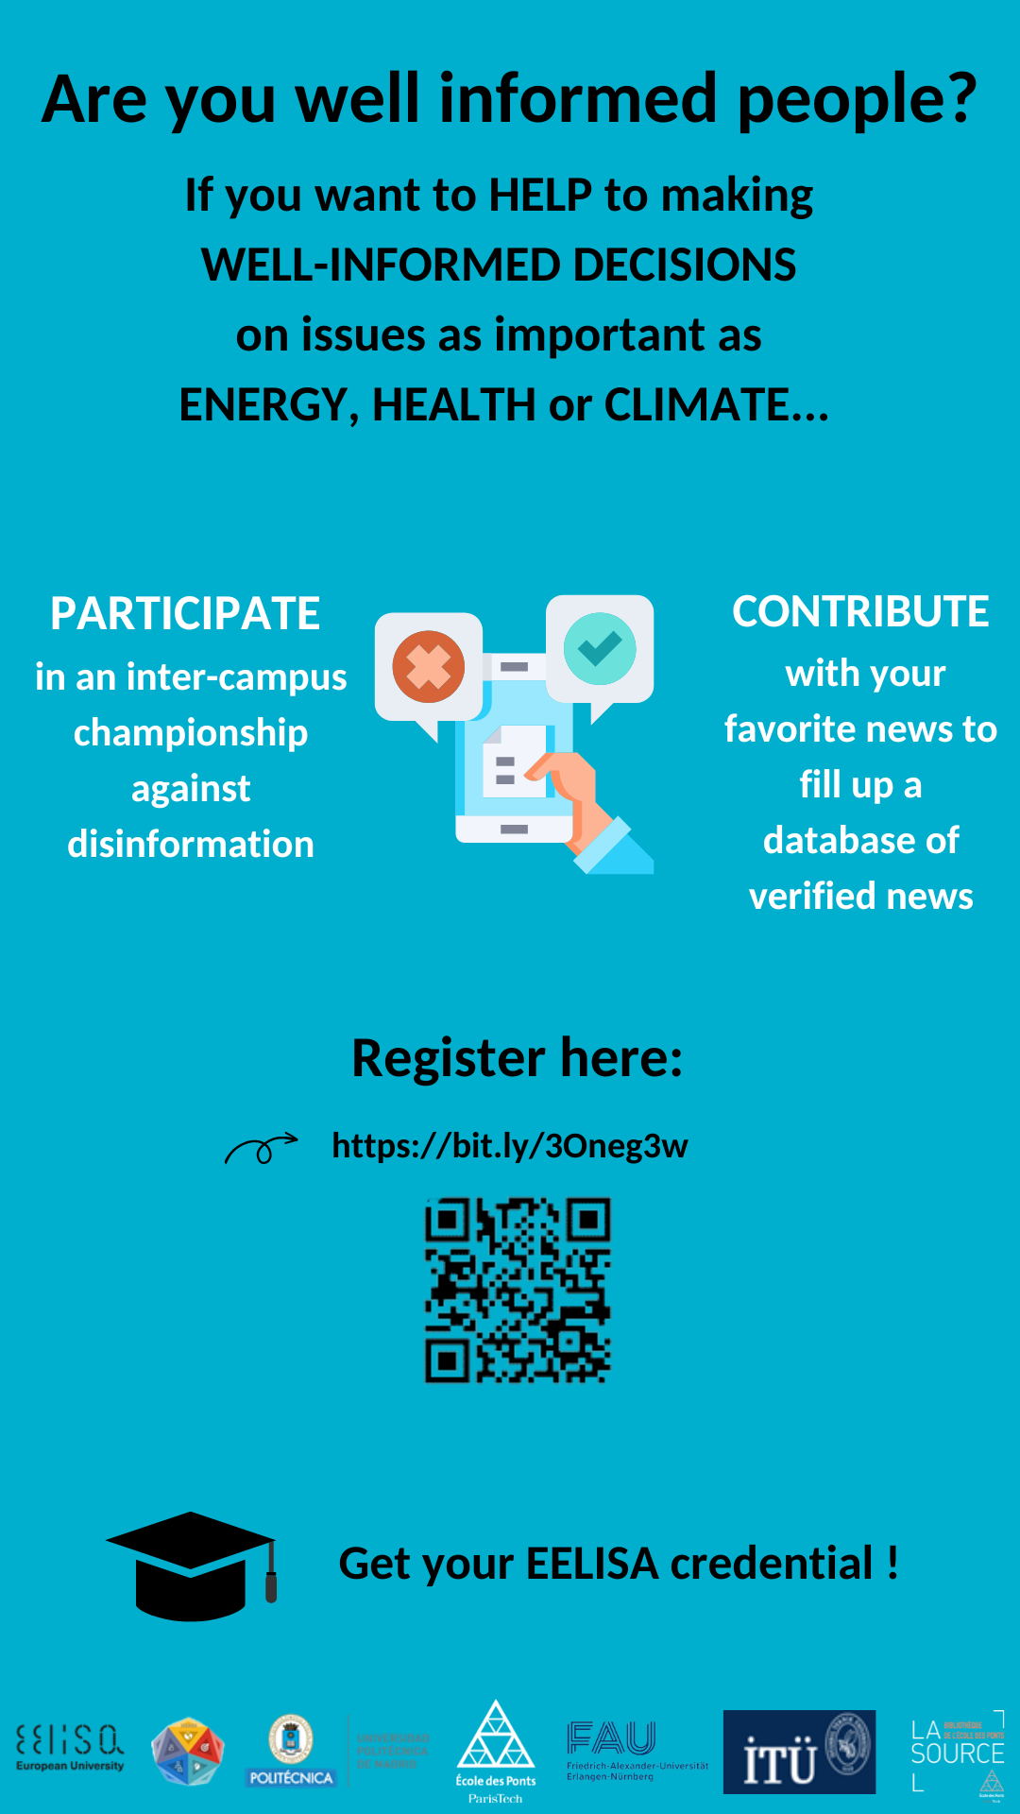
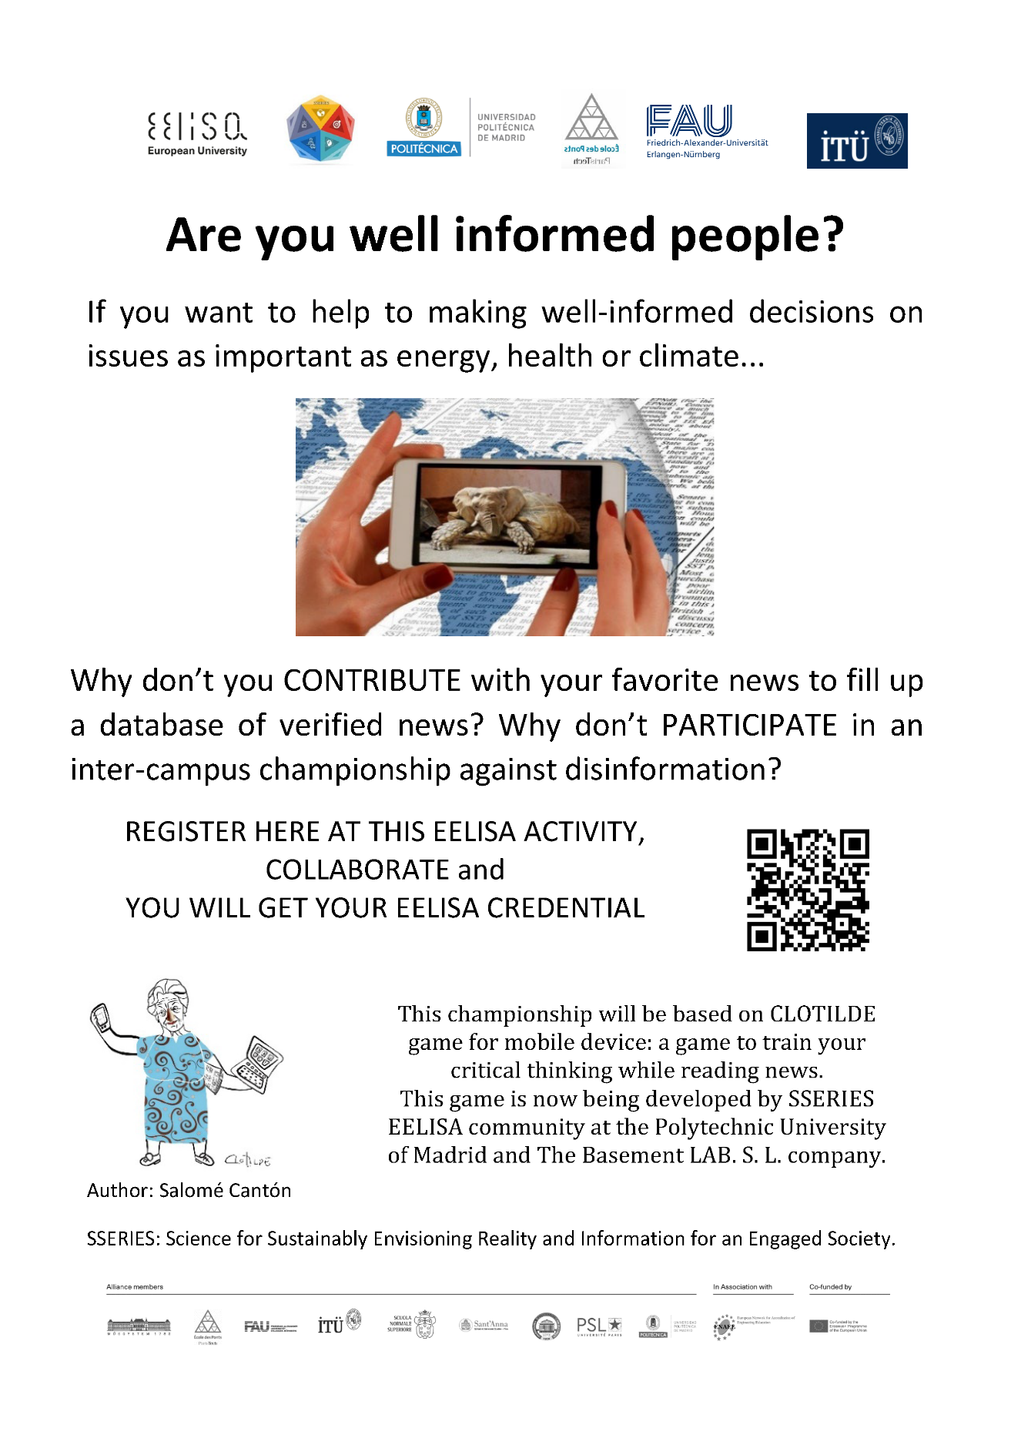
Evidences

Slide 7
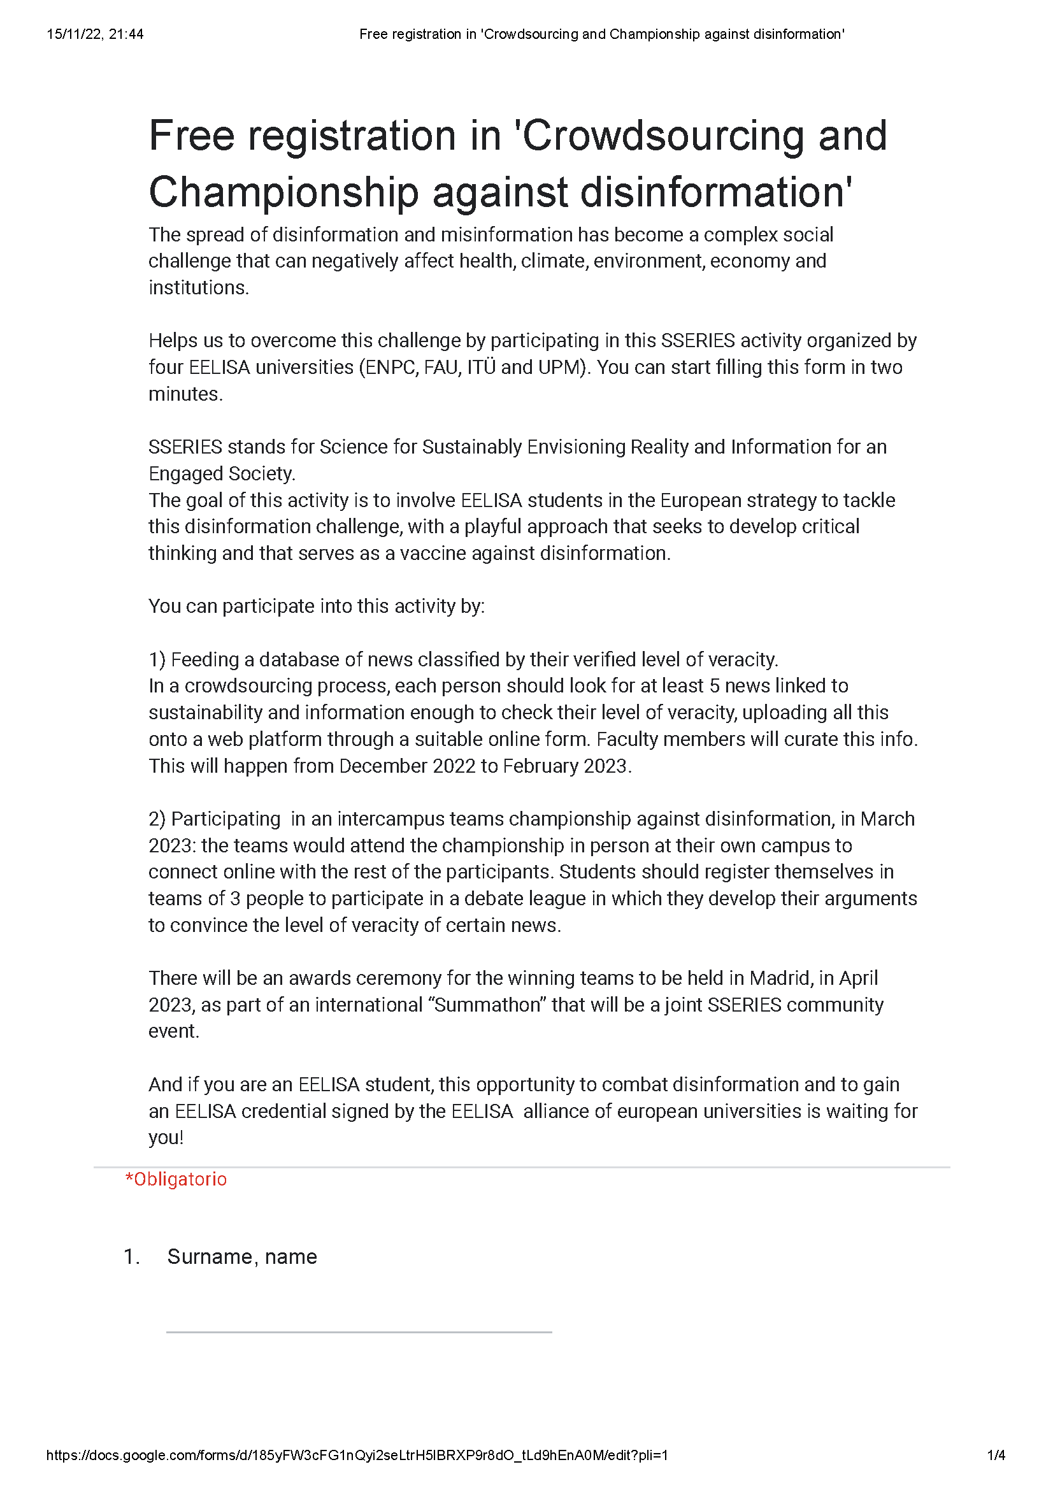
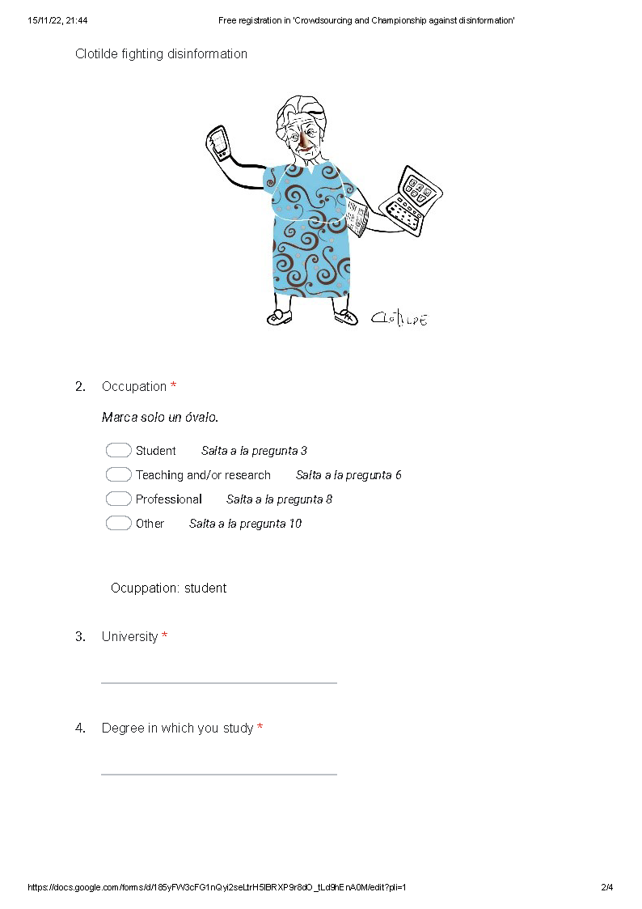
Evidences

Slide 8
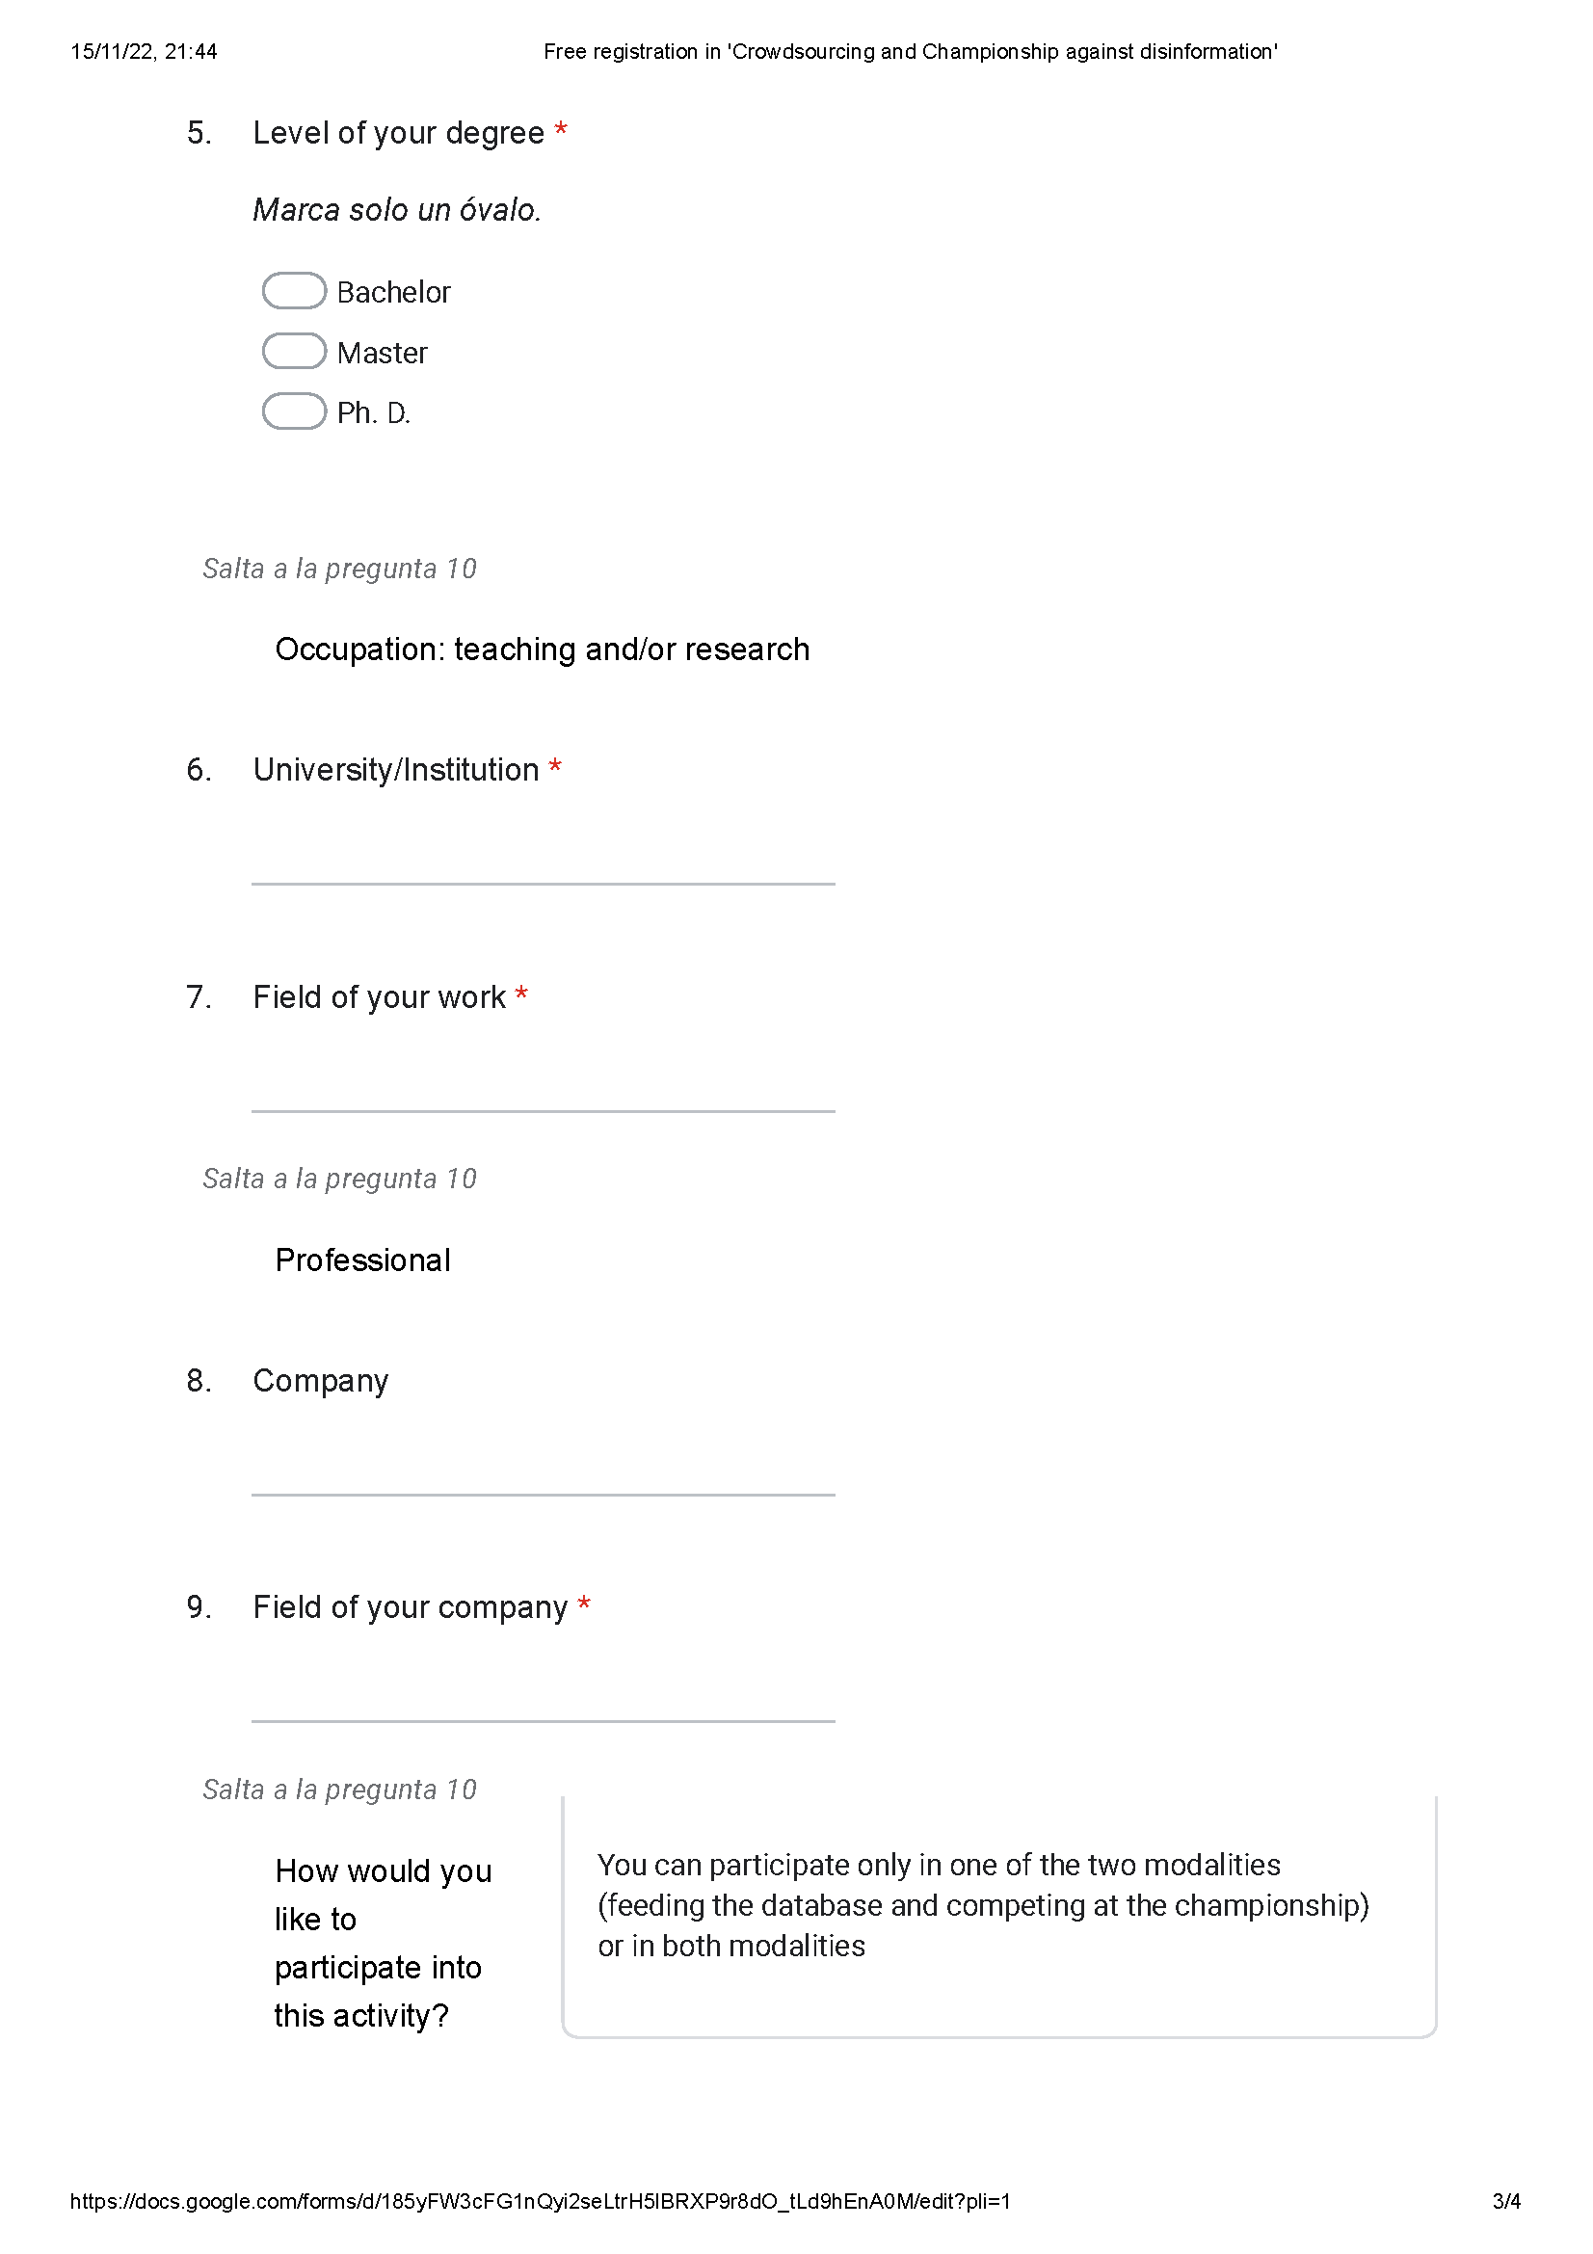
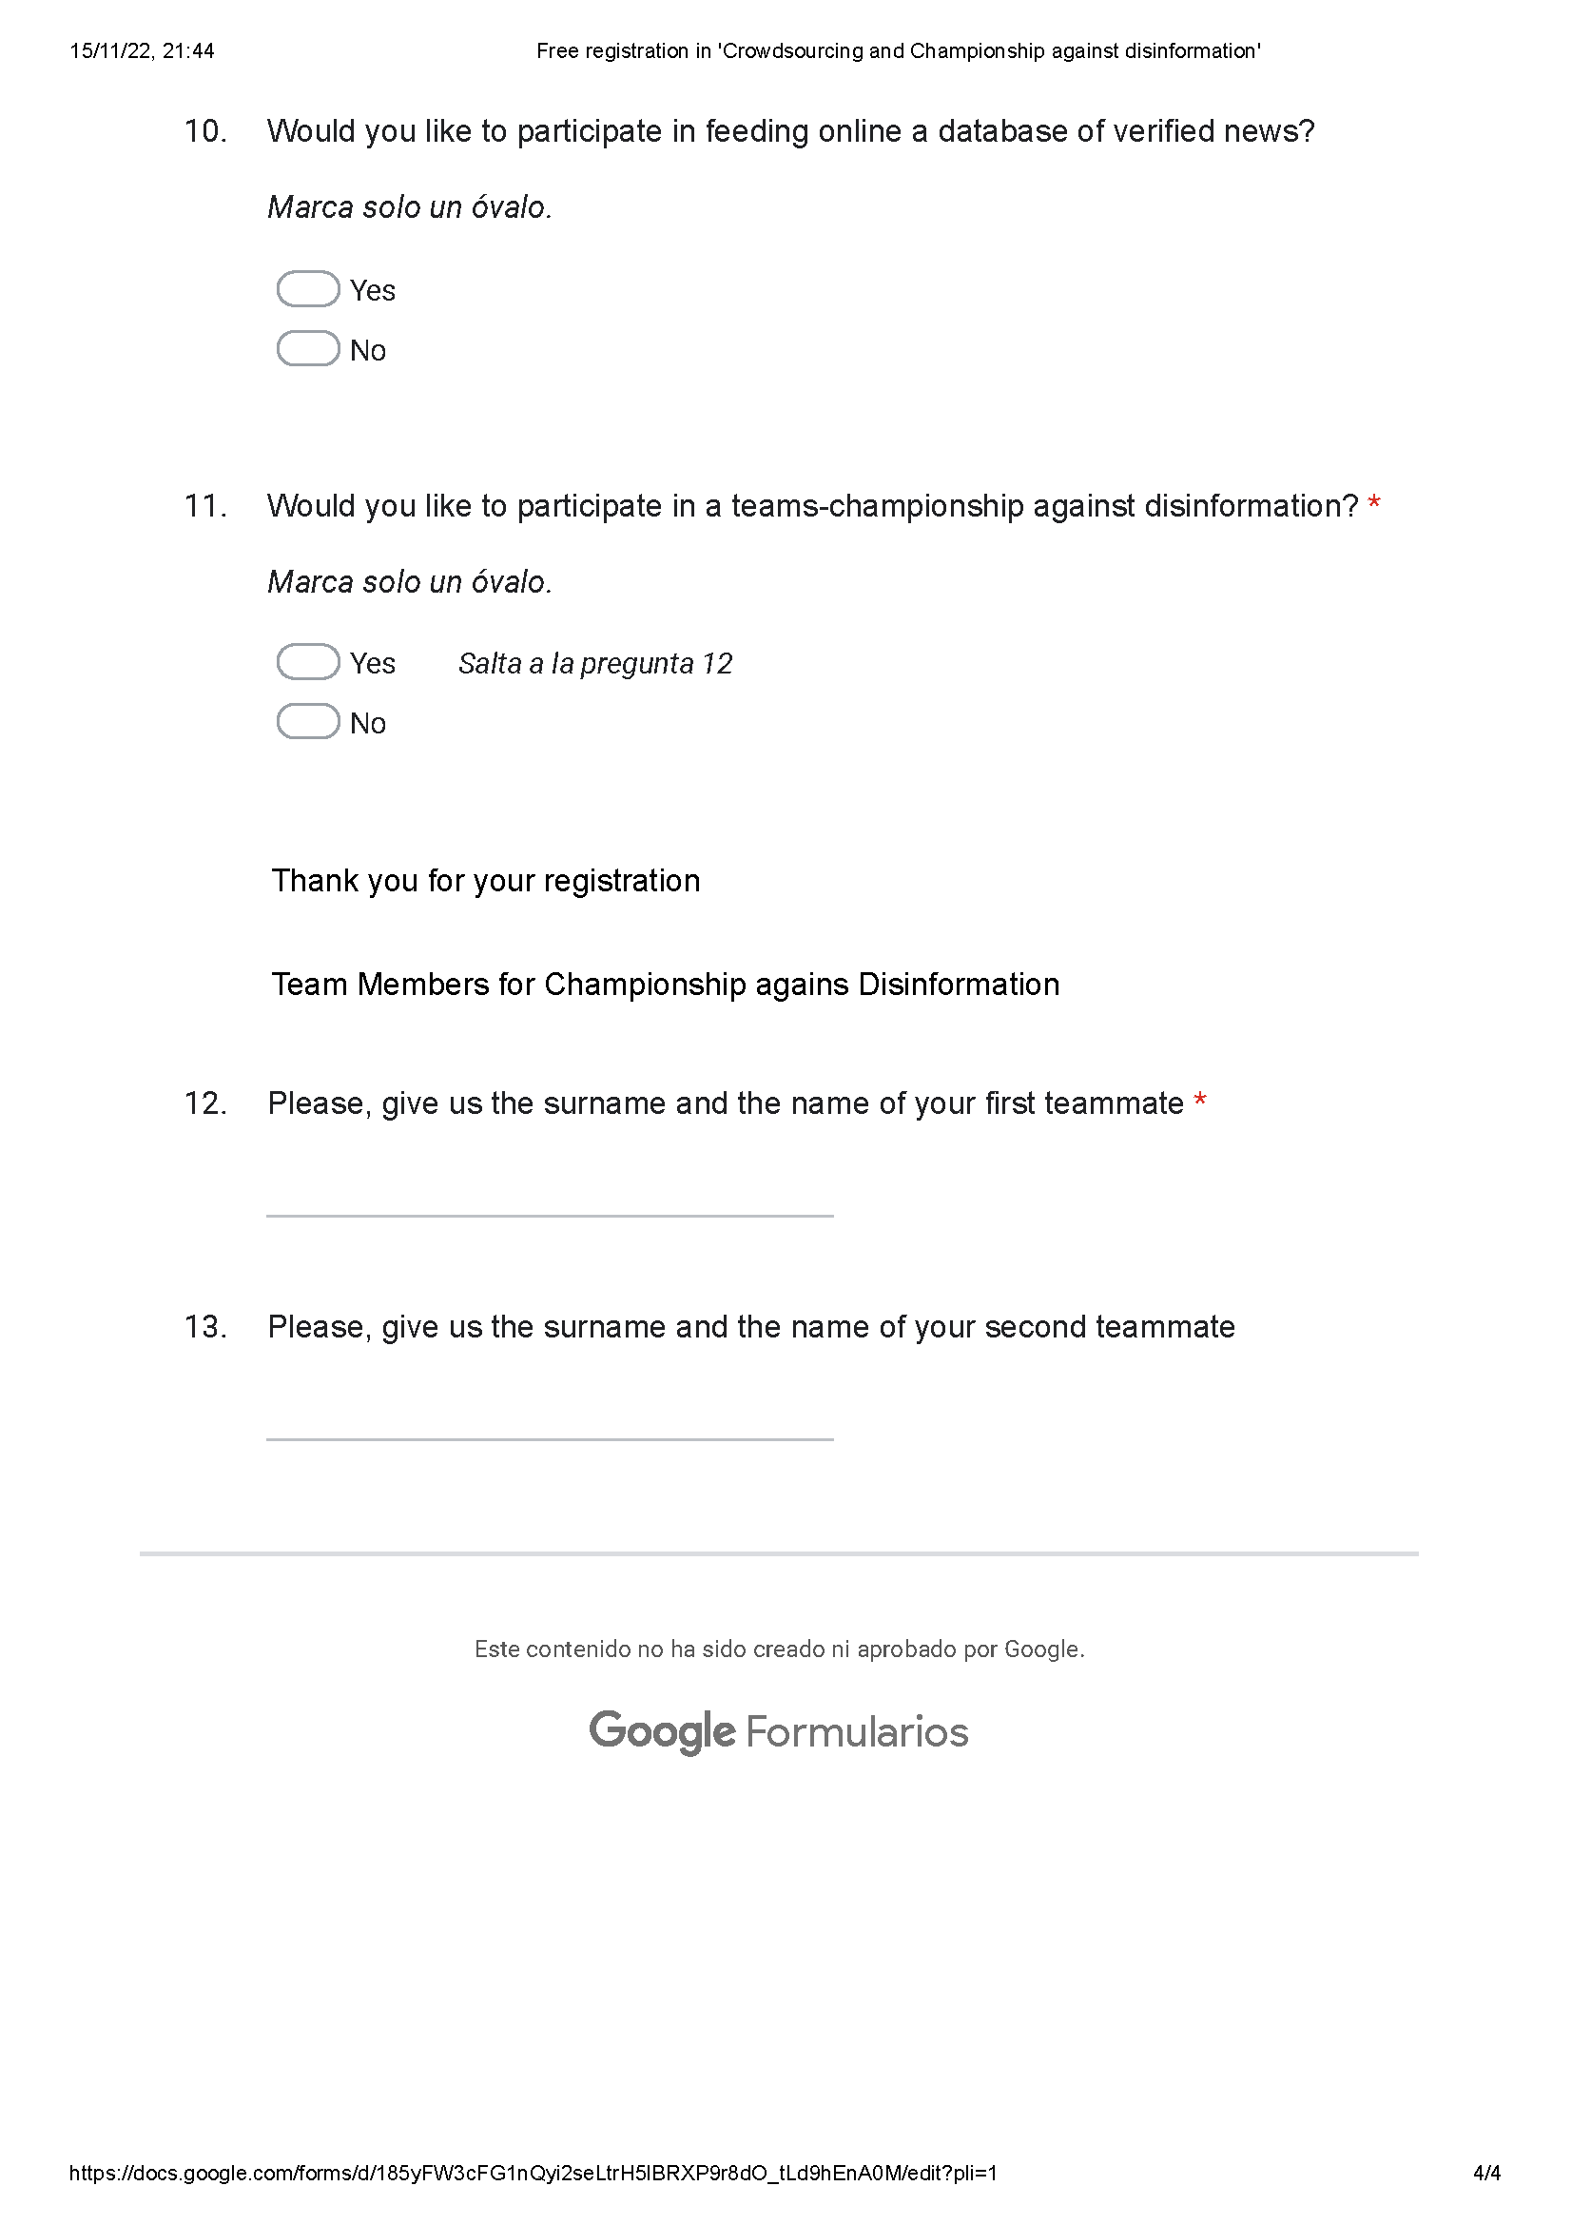
Evidences

Slide 9
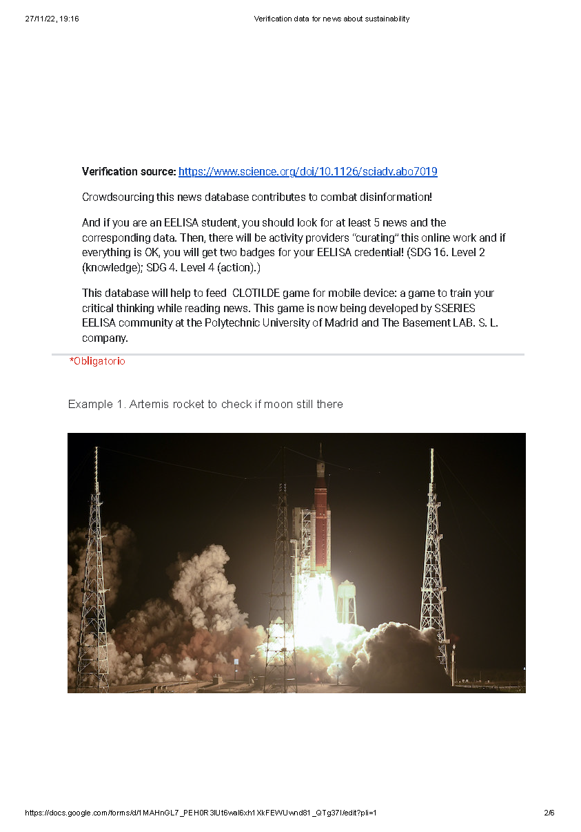
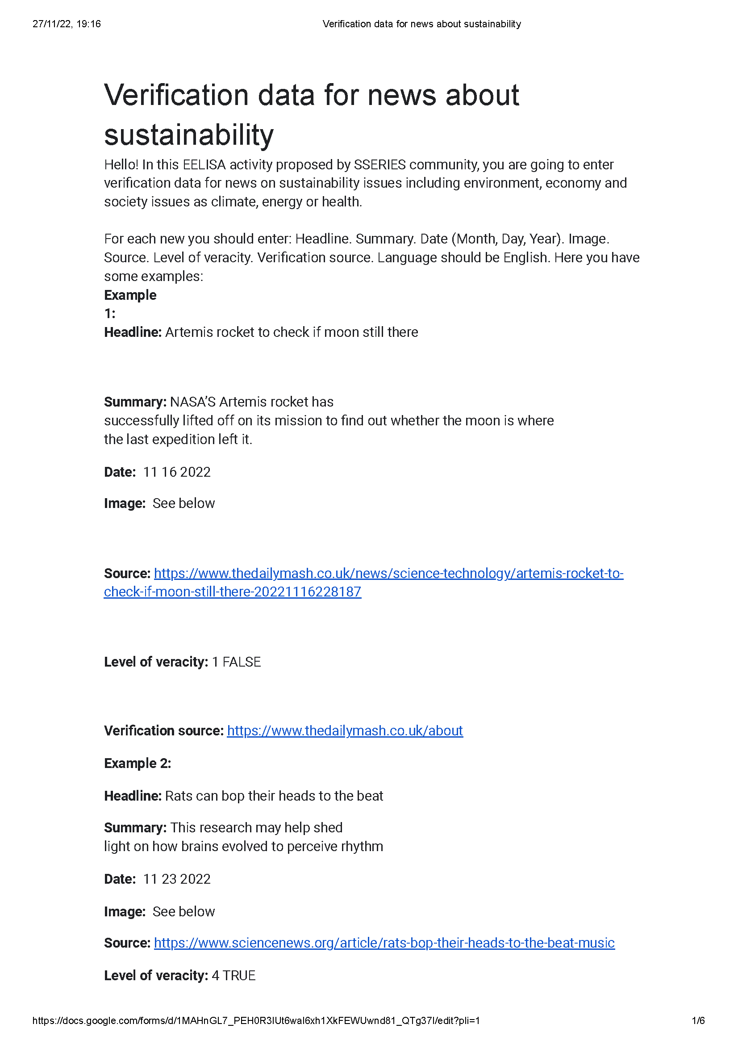
Evidences

Slide 10
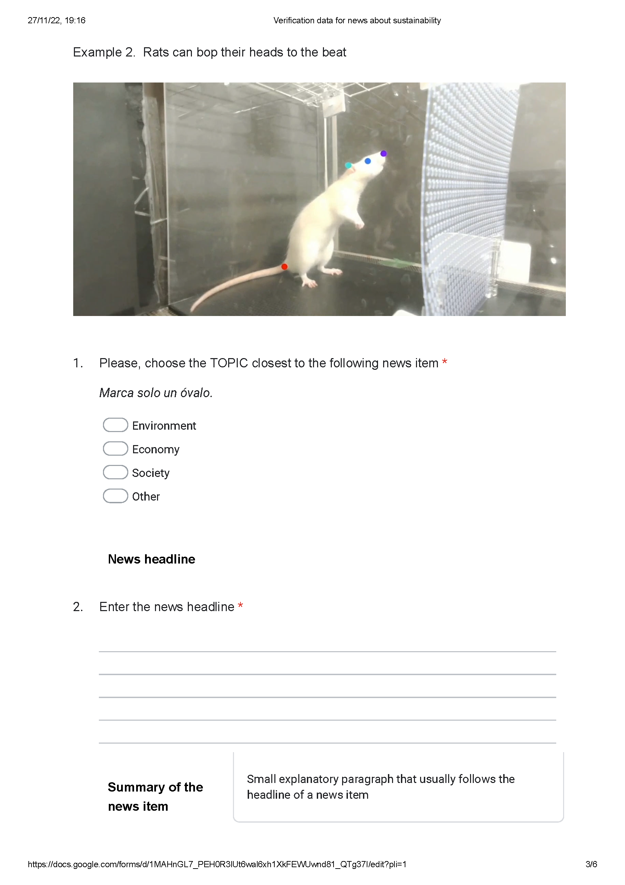
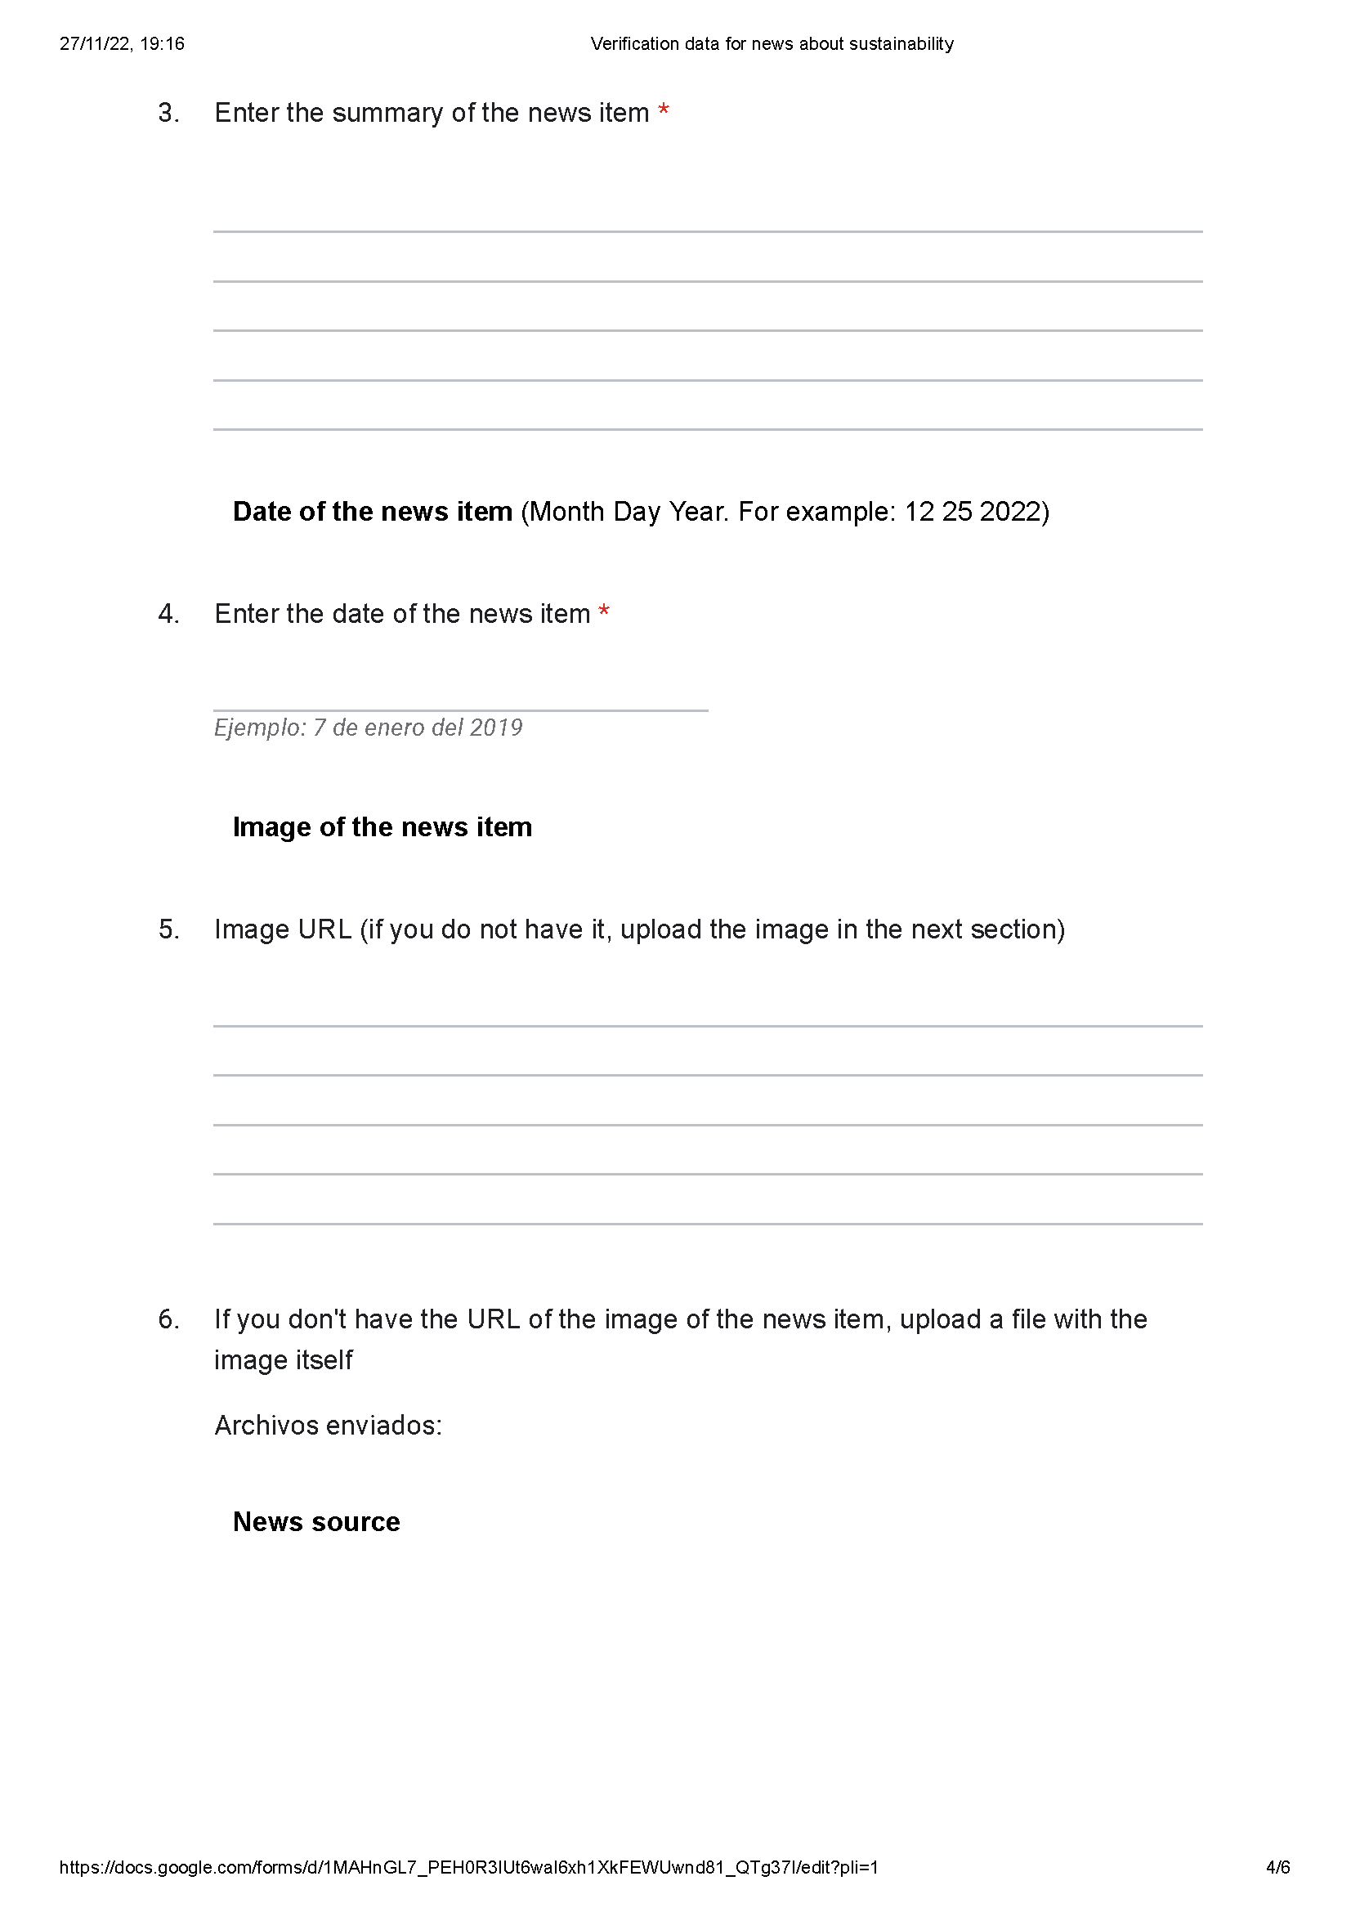
Evidences

Slide 11
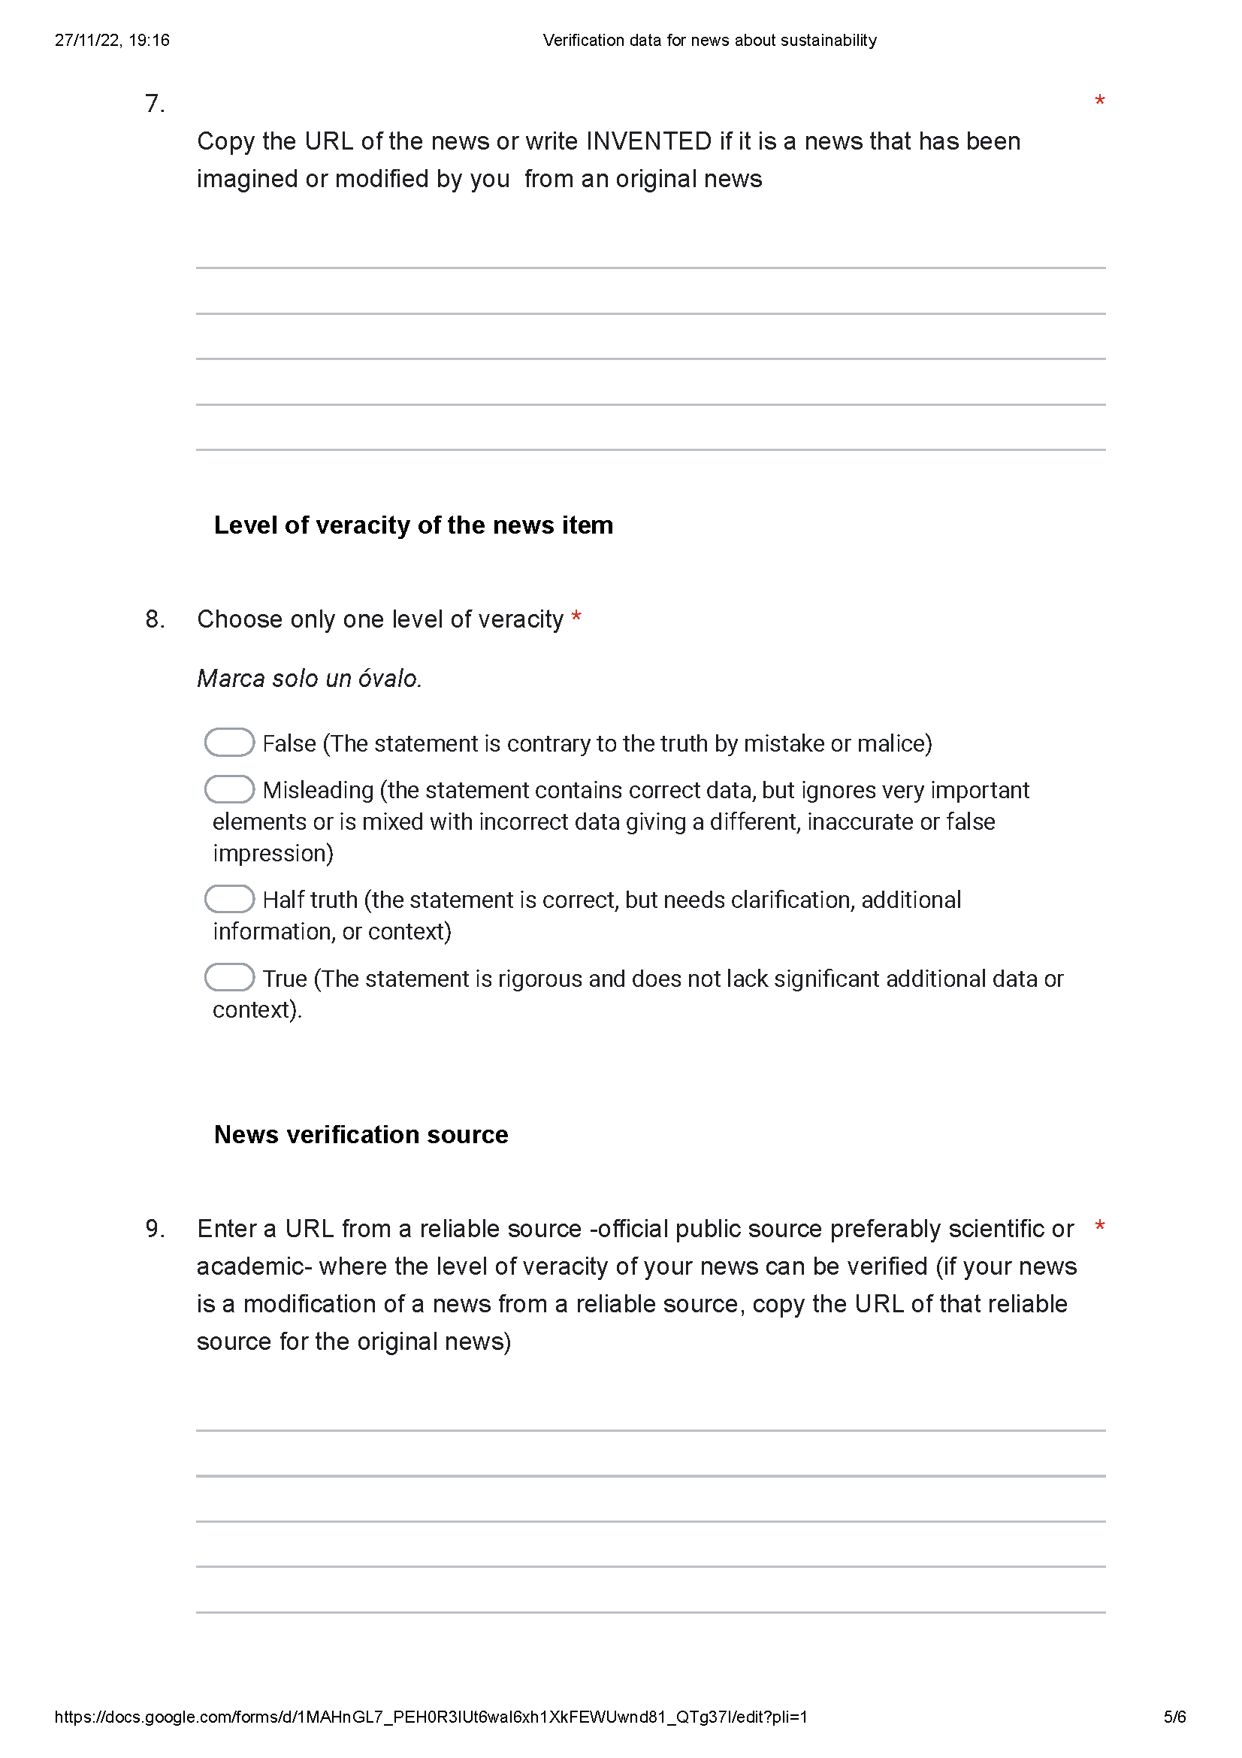
Evidences

Slide 12
Disclaimer
EELISA IS

