Slide 1
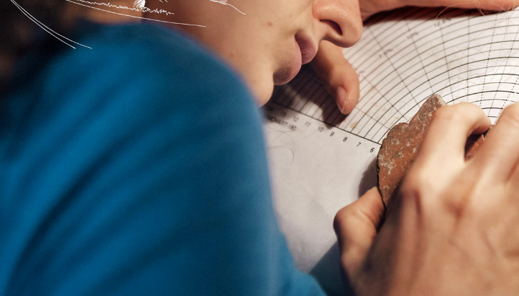
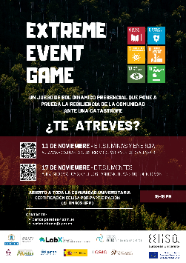



EELISA ACTIVITY
Extreme Event Game:
(Earthquake!)
Date of the activity: 11th nov.22
Organized by: Water in an era of change
Sponsors/other stakeholders: IGME-CSIC, LabX National Academy of Sciences, UNDRR
Location: UPM (Minas)
Format: Groups Face to Face:

Slide 2
















Description of the activity
ACTIVITY IN NUMBERS
# inscriptions: 49
# participants: 27
# badges: 3
# ECTS: 0.3
# Communities involved: 1
# mobilities: 1
Universities involved:UPM (Acronyms of the universities)
Extreme Event is an award-winning in-person role-playing game that gives participants a taste of what it takes to build community resilience in the face of disaster. Players work together to make decisions and solve problems during an engaging, fast-paced disaster simulation. There are three scenarios from which to choose: earthquake, hurricane, or flood, according to the desired resilience training.
Any group of 12-48 adults or teens can play Extreme Event. It has been used by community groups, in classrooms, and as part of volunteer and teacher training activities. It is cross-disciplinary, so fits well in many different contexts. Developed by the National Academy of Sciences’ Marian Koshland Science Museum (now LabX) in collaboration with the Resilient America Roundtable, Extreme Event’s content draws on recommendations from the seminal 2012 National Academies consensus study report Disaster Resilience: A National Imperative and has been reviewed by experts and staff of the National Academies.
SDGs:
Impact: 3
Impact: 2
Impact: 4

Slide 3
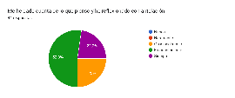
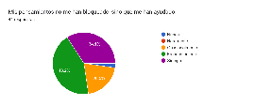
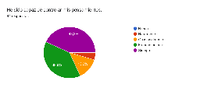
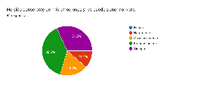
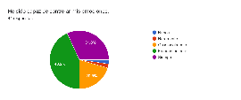
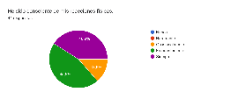
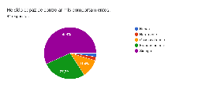
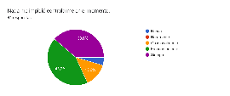
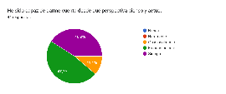
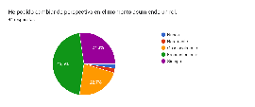
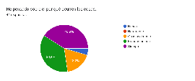
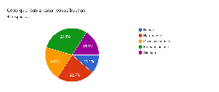
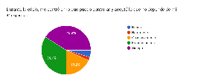
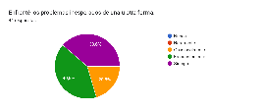
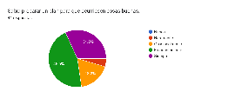
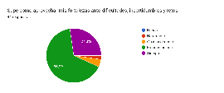
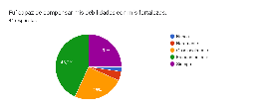
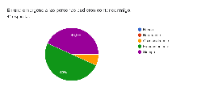

Results
Results of the activity in one page: Resiliency evidences of participants along EEG
Assessment method:
two Google form surveys, pre EEG and post EEG 19+19 questions with Likert scale

Slide 4
Lessons learned [in one page]
What’s work out
direct contact with potentially interested students
group activity, inclusive, interactive, with plenary session
include an ice-breaker part
circular format: pitching the topic and why + development and work + discussion and conclusion on topic
What we can improve
we (can) must do to improve:
communication with students, teachers and stakeholders of the proposed activities: communication with students, teachers and stakeholders of the proposed activities.
the dissemination and advertising of the activities in social networks
specify the way in which students are really interested in the activity carried out so that it has an effective outcome for them.

Slide 5
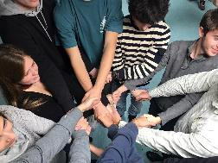
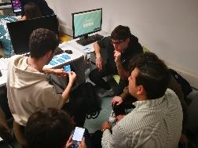
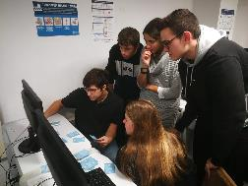
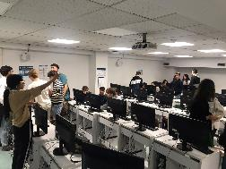
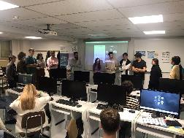
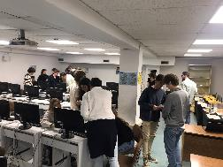
Evidences
https://m.facebook.com/story.php?story_fbid=2373719676116774&id=100004362948712

Slide 6

Disclaimer
EELISA IS

Slide 7
