Slide 1
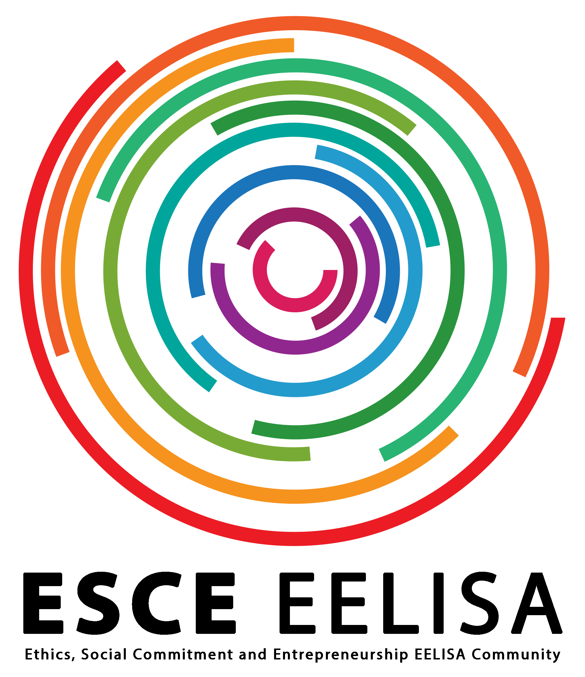
EELISA ACTIVITY
International Cooperation Workshop
Date of the activity: 27 June 2022
Organized by:
ONGAWA
Ethics, Social Commitment & Entrepreneurship
Sponsors/other stakeholders:
Adjuntía para Cooperación Internacional UPM
Location: UPM
Format: Face-to-Face

Slide 2
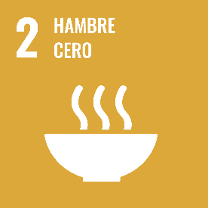
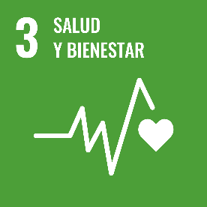
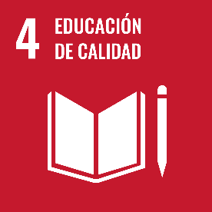
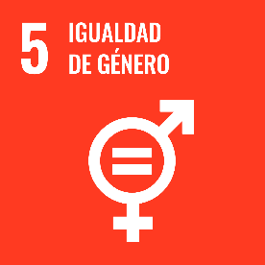
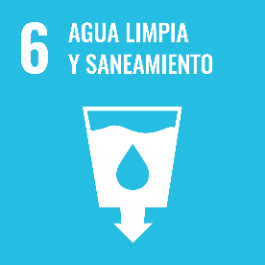
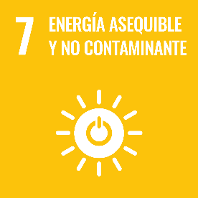
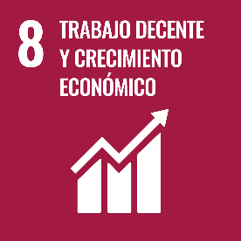
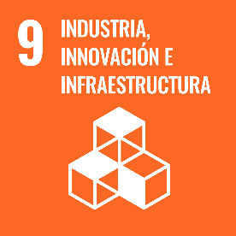
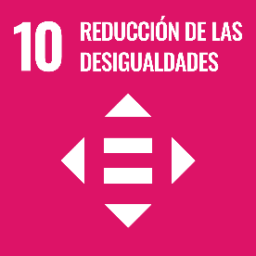
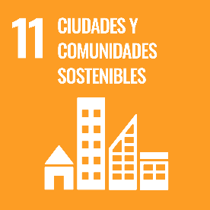
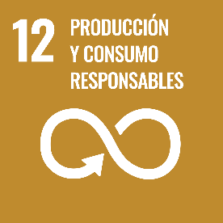
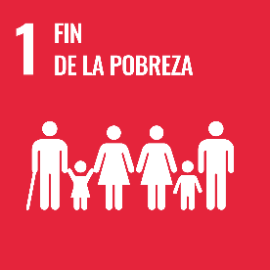
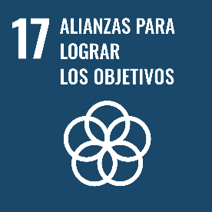
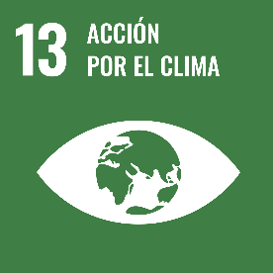
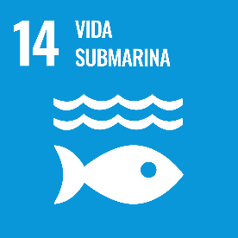
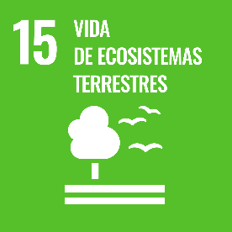
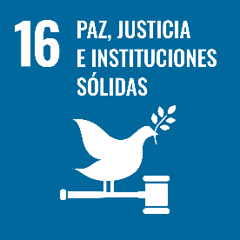
Description of the activity
ACTIVITY IN NUMBERS
# inscriptions: 5
# participants: 5 # badges: 5
# ECTS: -
# Communities involved: 1
# mobilities: -
Universities involved: UPM
A one-day workshop with the aim of contributing to the skill development of UPM students, promoting their understanding of development cooperation in technology-based actions from a human rights-based approach, incorporating the paradigms that provide a transformative vision of interventions, within the framework of the 2030 Agenda.
SDGs:
Impact: 1
Impact: 1

Slide 3
Results
Results of the activity in one page
A 4-hour face-to-face training session in which the students learned from development cooperation professionals (ONGAWA) about:
The concept of “Leaving No One Behind” in relation to SDG6 Water and Sanitation for All
How to identify vulnerable people and groups and who are being left behind in relation to SDG6, with a special focus on SDG5 Gender Equality
The Human Rights Based Approach (HRBA), especially the Human Right’s principles and the roles and responsibilities of the different actors involved in their guarantee
How to design a cooperation project from the HRBA perspective
Assessment method
A first part, structured in 2 sessions, focused on sharing theoretical and experience-based knowledge, and a second part of teamwork to discuss how to implement the human rights-based approach in real development cooperation interventions

Slide 4
Lessons learned [in one page]
What we can improve.
The training offer aroused interest, but in the end less than half of the initially registered participants took part in the workshop.
It is necessary to launch the training offer earlier and to avoid overlaps between activities aimed at the same target group
What’s work out
Understanding the most theoretical concepts from their application in practice.
Learning based on good practices and success stories, but also on mistakes and failed projects.
Cooperation between the university and NGOs working directly in the field.

Slide 5
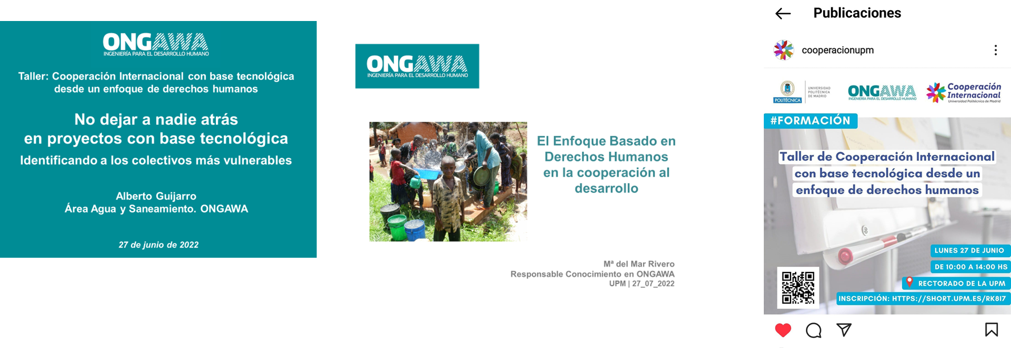
Evidences

Slide 6
Disclaimer
EELISA IS

