Slide 1
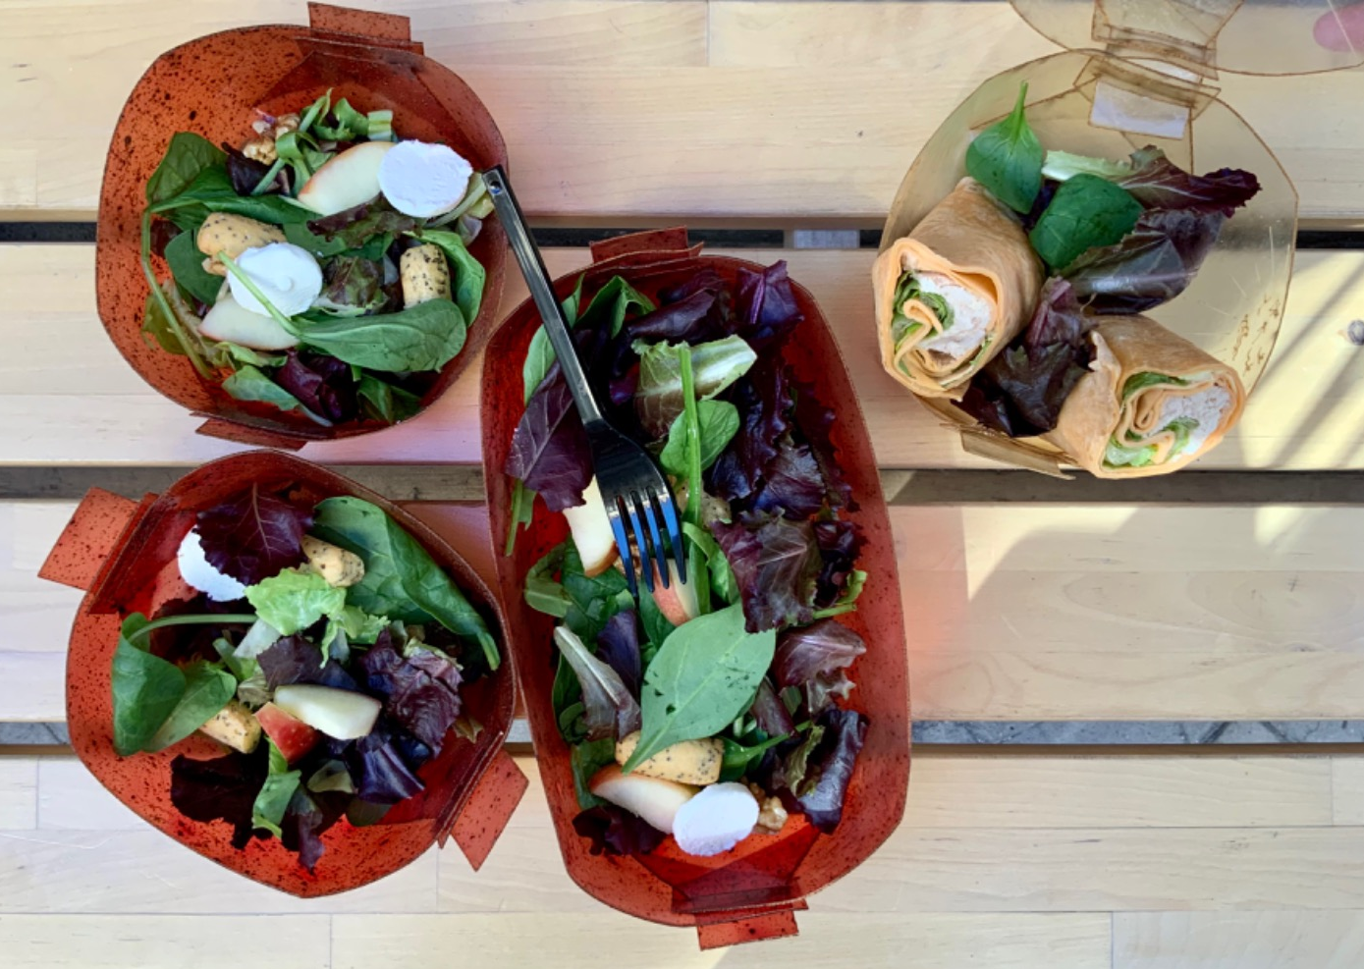
EELISA ACTIVITY
TFG_Design, development and manufacture of a biodegradable take-away container for restaurants in the Lavapiés neighborhood. Nuria Barahonas
Date of the activity: May 2022
Organized by: Industrial Design and Innovation for Sustainable Human Welfare
Sponsors/other stakeholders: SIKA, FACYRE
Location: ETSIDI
Format: Face to face

Slide 2
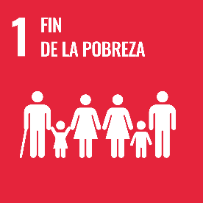
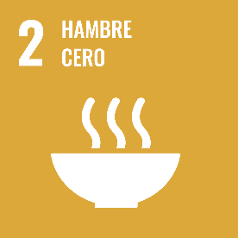
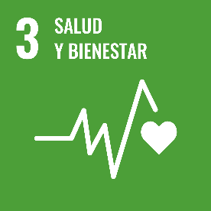
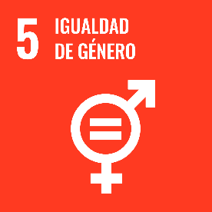
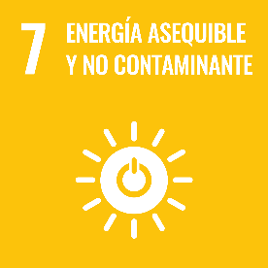
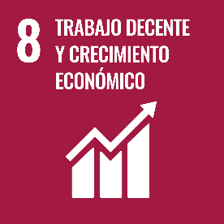
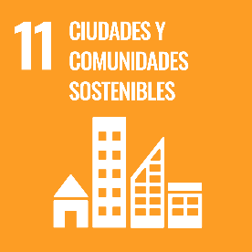
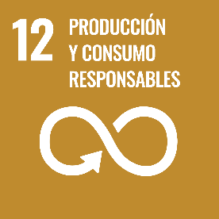
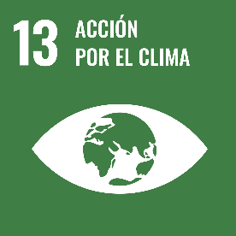
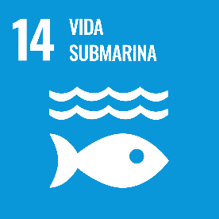
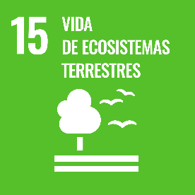
Description of the activity
ACTIVITY IN NUMBERS
# inscriptions: 1
# participants: 1
# badges: 1
nuria.barahonas@alumnos.upm.es
# ECTS:
# Communities involved: 1
# mobilities:
Universities involved: UPM
In recent years, the use of biomaterials for packaging has increased due to greater awareness of the environmental advantages that these represent with respect to other materials. This is why I have chosen the design, development and manufacture of a biodegradable take-away container for restaurants in the Lavapies neigborhood as my final degree project.
Using the Cook it Yourself methodology I developed sheets of a biopolymer based on gelatin, glycerin, water and additives (which provide each sheet with a different colour and allow each restaurant to be identified by an additive linked to their type of food). I also designed and manufactured a take-away container with these sheets as the base, using laser cutting.
SDGs:
Extended Impact

Slide 3
Results
Thus, a material with the appropiate conditions to contain dry foods, which may have fat. This material can also withstand temperatures of up to 50 degrees. Biopolymers are already used in the world of packaging, but for the project to be applied to reality, a series of migration tests have to be carried out because it is a material in contact with food.
A material with the appropiate conditions to contain dry foods, which may have fat. This material can also withstand temperatures of up to 50 degrees.
Assessment method: Project

Slide 4
Lessons learned
What’s work out:
Weather conditions greatly influence the manufacture of the sheets and how they behave after drying.
Excessive humidity in the environment during the drying time can cause the appearance of mold on the sheets.
Once the sheets are dry, an excessively dry climate increases stiffness and an excessively humid climate increases flexibility.
As such, it would be difficult to achieve mass production. It is very complicated to control the final dimensions of each sheet since each one dries differently, thus making each container unique.
This is not necessarily a bad thing, as each container would be unique to the owner.
What we can improve:
Involve more communities.

Slide 5
Evidences

Slide 6
Disclaimer
EELISA IS

