Slide 1
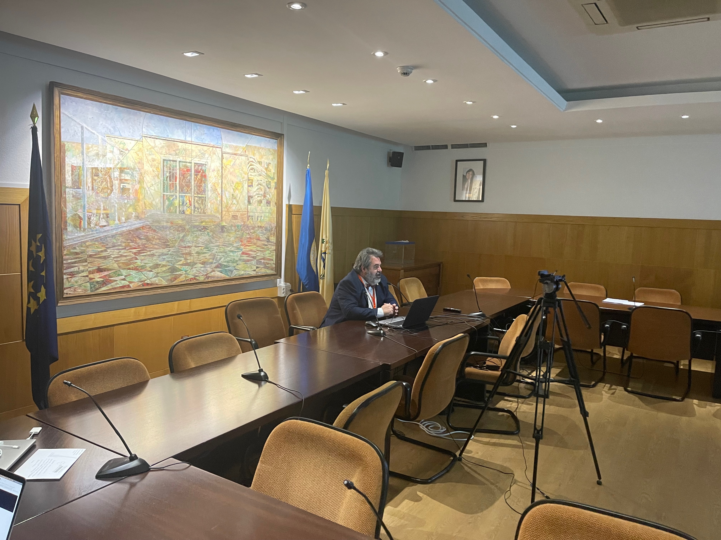
EELISA ACTIVITY
Roundtable: Challenges and advances in industrialized construction
Date of the activity: 17th Novembre 2022
Organized by: INCO-0
Sponsors/other stakeholders: BIMIC International Conference
Location: ETSEM
Format: Hybrid

Slide 2
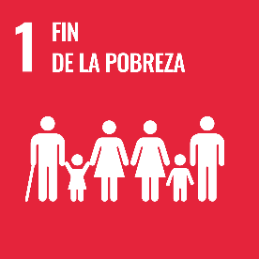
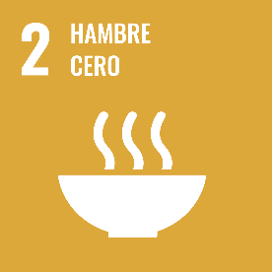
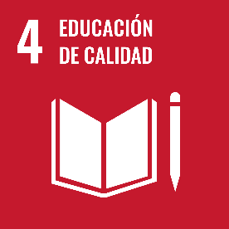
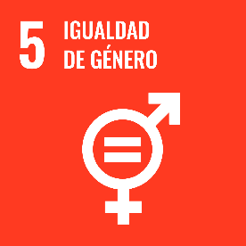
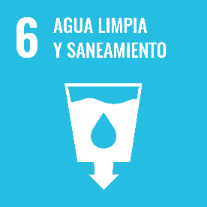
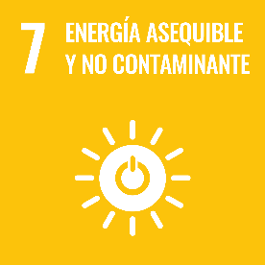
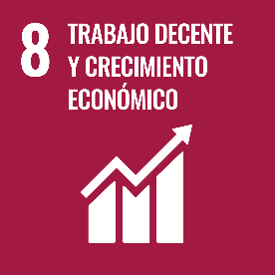
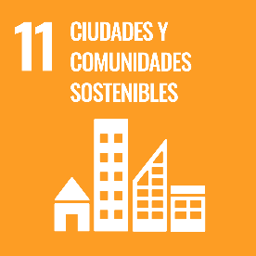
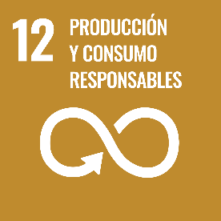
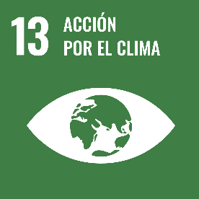
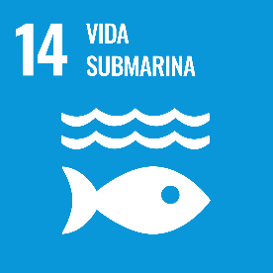
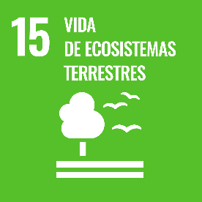
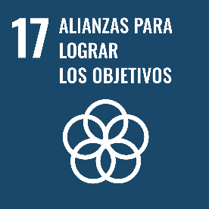
Description of the activity
ACTIVITY IN NUMBERS
# inscriptions: 30
# participants: 30 # badges: 30
# ECTS: 0
# Communities involved: INCO-0
# mobilities: 0
Universities involved: UPM
During the 4th International BIMIC Conference, the INCO-0 community organized a roundtable where national and international experts on industrialized construction discussed challenges and advances in the field. Participants were able to participate both face-to-fase and virtually via Zoom.
SDGs:
9: Impact 2
11: Impact 2

Slide 3
Results
Participants learned about challenges in the field of industrialized construction and were able to identify areas for research in the future.
Assessment method: Debate and folow-up discussion after the presentations

Slide 4
Lessons learned
What’s work out. Presence from international participants. The hybrid format of the activity reached a higher number of participants, specially from Brazil
What we can improve: Due to conflict in the agenda of one of the speakers, he was not able to participate.

Slide 5
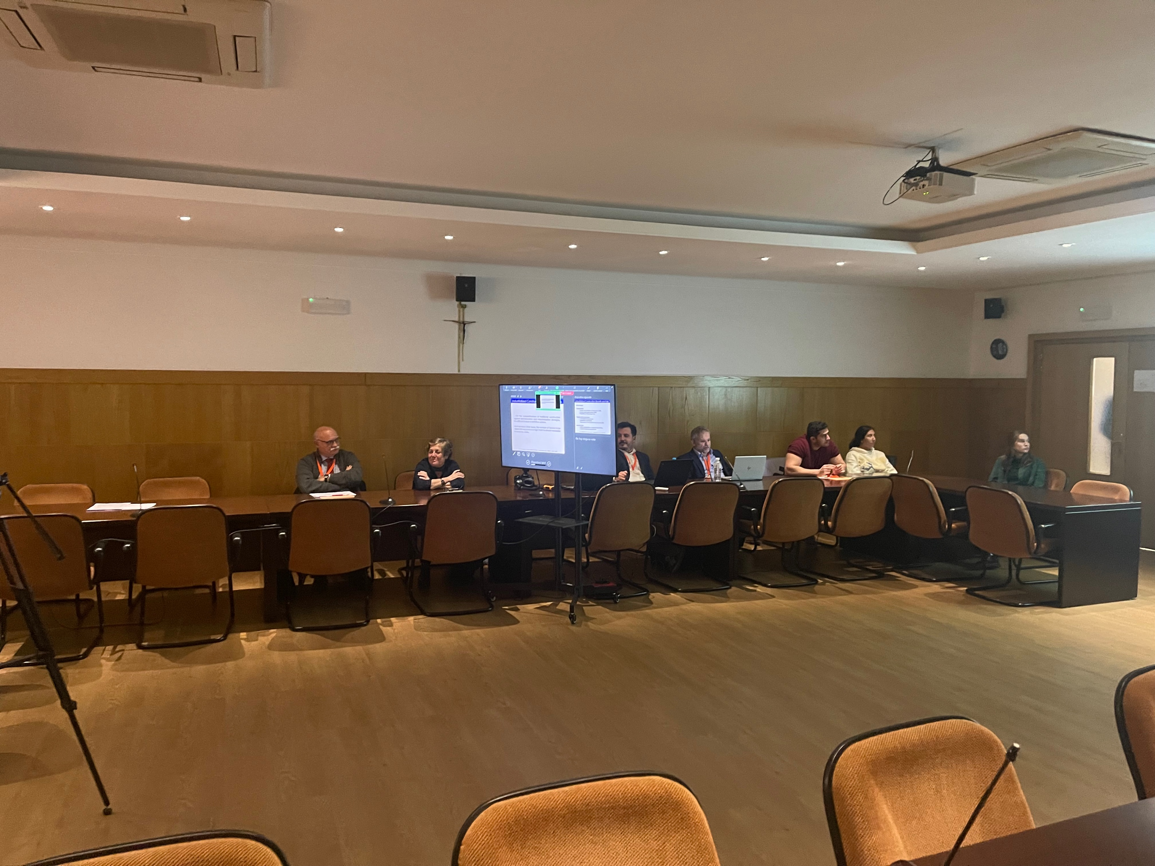
Evidences
https://eventos.upm.es/86014/detail/4thnbuilding-and-management-international-conference.html

Slide 6
Disclaimer
EELISA IS

