Slide 1
EELISA ACTIVITY
SSoLDAC - 2nd Summer School of Linked Data in Architecture and Construction
Date of the activity: June 6 to 10 2022
Organized by:
María Poveda Villalón (ETSI Informáticos) and
Raúl García Castro (ETSI Informáticos)
Sponsors/other stakeholders:
Technische Universiteit Eindhoven, University College London, University College Dublin, Ghent University, Rheinisch-Westfälische Technische Hochschule Aachen, Building Digital Twin Association, AEC3, CERTI, BIM Connected, NEANEX, Ontotext, Nirás,
Location: Residencia UPM Lucas Olazabal
Format: Face to Face

Slide 2
Description of the activity
ACTIVITY IN NUMBERS
# inscriptions: 43 requests, 30 accepted
# participants: 40 (30 students)
# Communities involved: BCC, DISCOVERY
# mobilities: XXX
Universities involved: UPM, UCL, UCD, RWTH, TUE, Ghent
The 2nd Summer School of Linked Data in Architecture and Construction (SSoLDAC2022) was held in a conference facility belonging to the Universidad Politécnica de Madrid, in the Sierra de Guadarrama Mountains about 50 km from Madrid.
The summer school was organized around the following learning goals:
Learning about the technology, its benefits over other web technologies, and its development workflows with high quality lectures from experts in the field;
Gaining experience in designing and querying ontologies and applying them in a practical context in the Summer School’s hands-on coding challenge;
Exploring the already existing approaches to describe Linked Building Data and come up with new ideas on how LBD can support your use cases, and innovative solutions to deal with the complexity of the built environment.
SDGs:

Slide 3
Results
Successful training for 30 students on semantic web technologies applied to the architecture and construction domain
Networking and strength collaborations between PhD students, senior researchers, professors and industry stakeholders
Challenge-based: students were asked to developed and present a solution for the challenge they choose (from 5 challengues descritpion)
Satisfaction survey: students were asked to evaluate the summer school organization and content by means of a survey

Slide 4
Lessons learned [in one page]
What’s work out
UPM residence environment
Preparation of challenges and material in advance
What we can improve..
Time allowed for challenge development

Slide 5
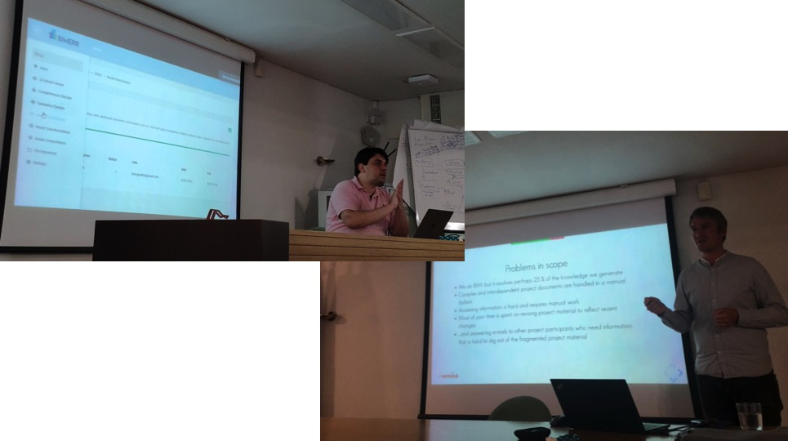
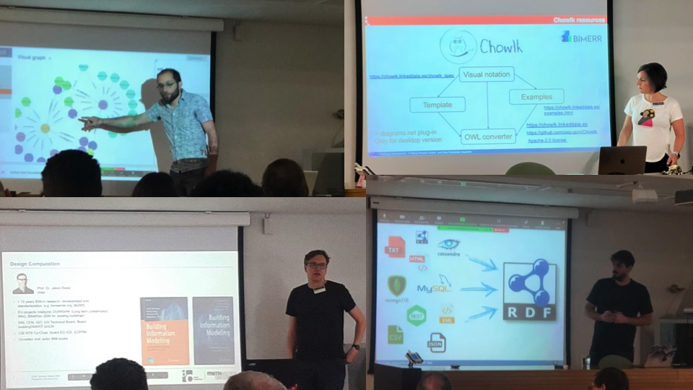
Evidences
https://linkedbuildingdata.net/ldac2022/summerschool/

Slide 6
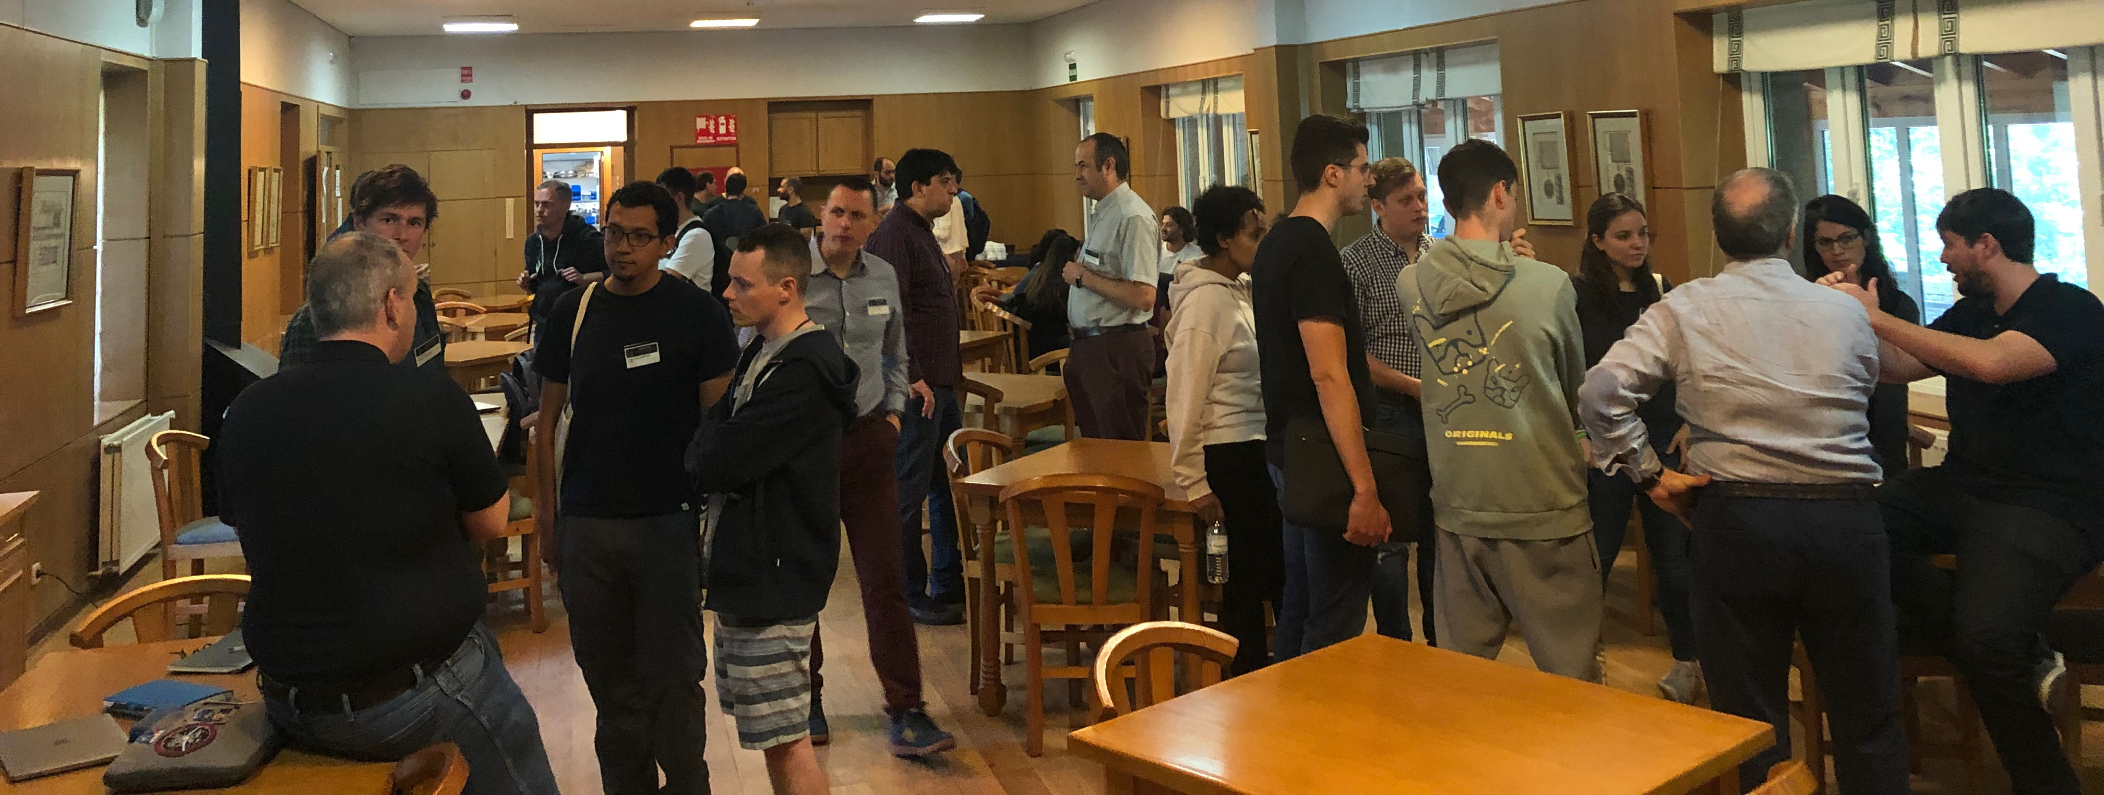
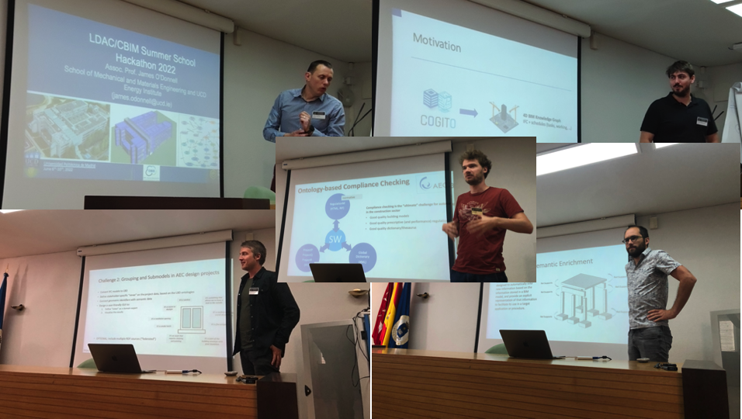
Evidences

Slide 7
Disclaimer
EELISA IS

