Slide 1
EELISA ACTIVITY
Green-MUCTA
VERDE Pre-certification
Self-assessment
Date of the activity:
From 10/21 to 6/22
Organized by: Sergio Vega Sánchez
Sponsors/other stakeholders:
GBCE (Green Building Council Spain)
Location: Madrid - ETSAM
Format: Face to Face

Slide 2
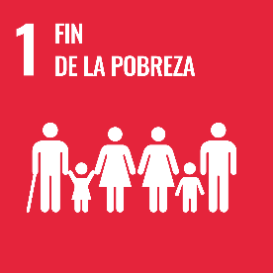
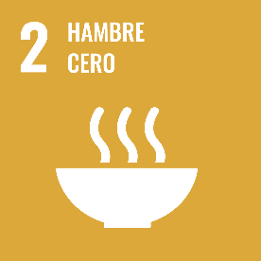
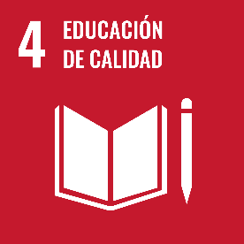
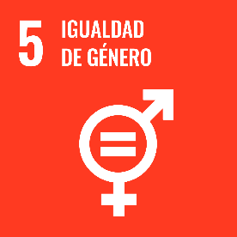
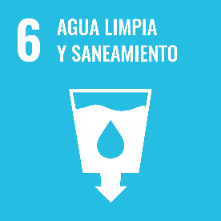
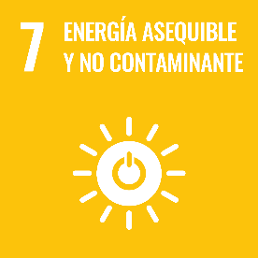
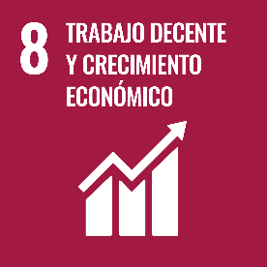
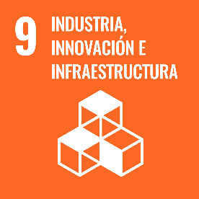
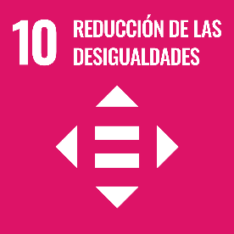
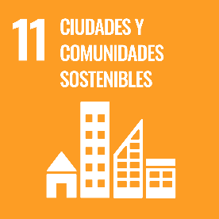
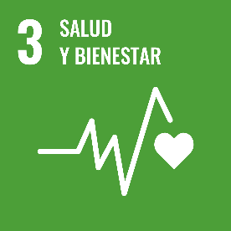
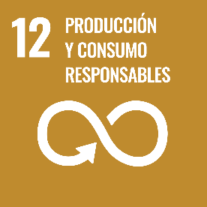
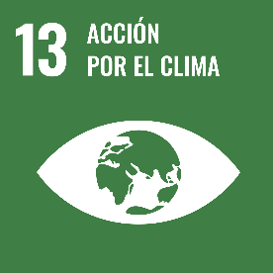
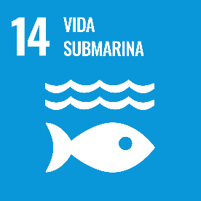
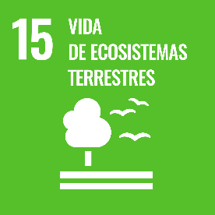
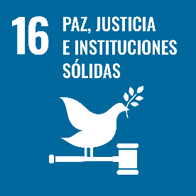
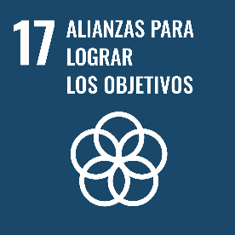
Description of the activity
ACTIVITY IN NUMBERS
# inscriptions: 8 students master degree
# participants: 8 # badges: 8
# ECTS:
# Communities involved: SUSBCC SUSTAINABLE BUILDINGS, CITIES, AND COMMUNITIES
# mobilities: None
Universities involved: UPM
In the UPM’s Oficial Master Degree in Construction and Building Technologies - MUCTA, students learn to think in technical terms through the classes and the development of an execution project from an architectural, functional and constructive point of view, which makes up the Master's Thesis., complying with all the Spanish technical and performance regulations.
This experience has been reinforced this edition with new theoretical-practical classes of a new subject (30h about Building Sustainability) and two new classes about how to think energy efficient and sustainable buildings and how to design them. Finally, a 6h workshop conducted by GBCE on how to evaluate a sustainable building according to the VERDE tool developed by the Green Building Council Spain, and how a self-assessment can be done as a pre-certification.
Students incorporate energy efficiency and sustainability strategies into their projects and apply the tool to their project by qualitatively assessing each and every one of the 46 evaluation topics for buildings. We challenge students to improve their projects to achieve a rating of three VERDE leaves.
Students not only gain an in-depth understanding of all the qualities sought in a sustainable building (a 700-page manual on why and how to evaluate them is provided), but also have the option to improve their project by incorporating these strategies in their projects design.
It is hoped that with the scheduled activities the students will become aware of sustainable design, understand the globality of the aspects that must be integrated, and will be able to apply this knowledge to make buildings and cities more sustainable in their daily professional activity in the future.
SDGs:
Impact:
11 – B.1 - 4

Slide 3
Results
Results of the activity:
All students in the Master Degree attend all the new scheduled classes as part of the regular training activity.
Students deliver at the end of the Master´s thesis the execution of their efficient and sustainable building projects. With the corrections and suggestions of the professor, and with the application of the self-evaluation tool, they will deliver the VERDE pre-certification (46 topics hopefully giving a grade of three VERDE leaves) together with a justification report.
Assessment method:
Attendance and written results with drawings of the efficient and sustainable building designed by the students, with a justification report describing the 46 strategies and the VERDE pre-certification (46 topics giving a grade of three VERDE leaves)

Slide 4
Lessons learned
What’s work out
All the students have worked hard developing creative strategies to make their buildings more and more efficient and sustainable reaching at least a rate of three VERDE leaves
This pilot activity is now part of the curricula to be provided by the MUCTA, so students must develop an efficient and sustainable building, committing them to more sustainable buildings and cities.
What we can improve
For the next edition We are going to challenge the students to reach 4 or 5 VERDE leaves, with at least 3 VERDE leaves rating.
Students must deepen in the justification of many of the 46 topics assessed.

Slide 5
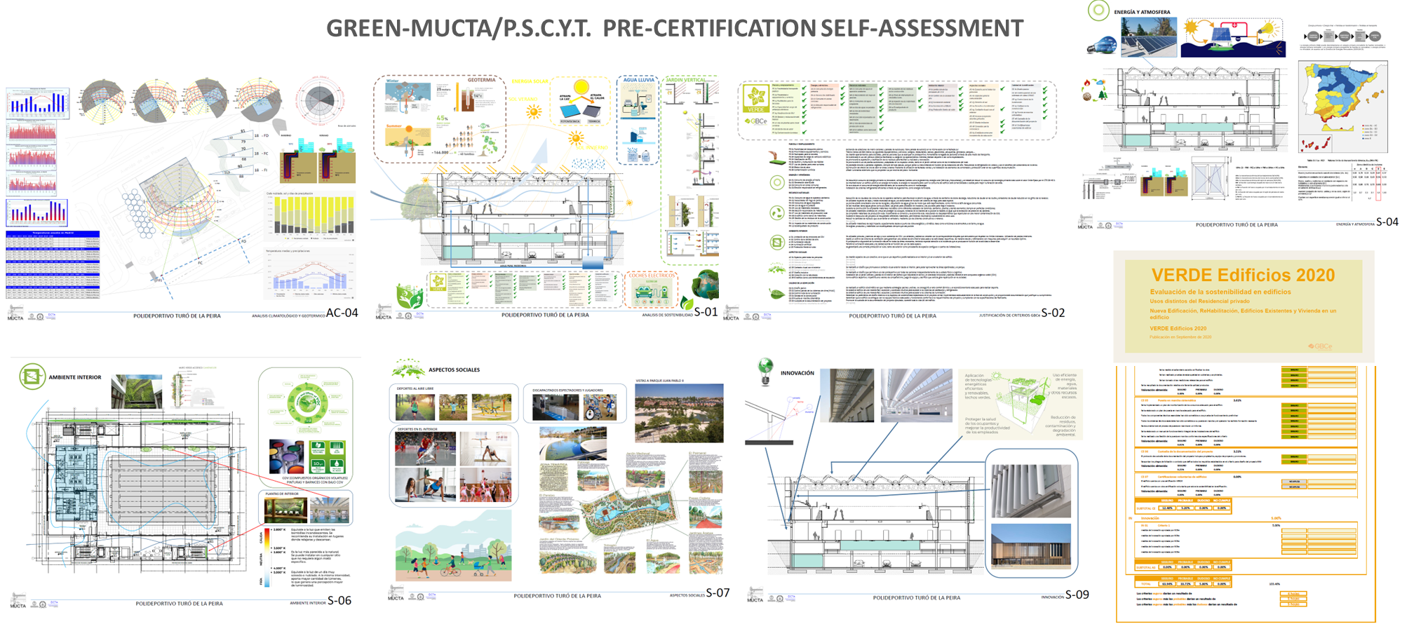
Evidences
Some images as example of one of the projects developed:

Slide 6
Disclaimer
EELISA IS

