Slide 1
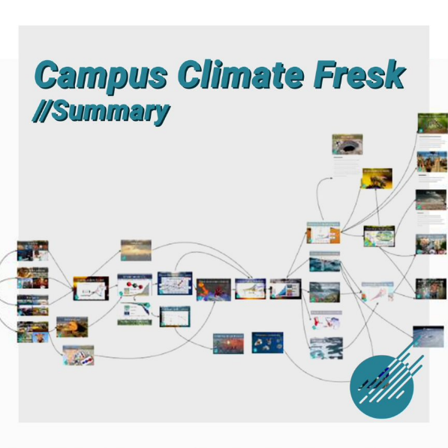
EELISA ACTIVITY
Campus Climate Fresk and GHG emission master class
Date of the activity: May 16 and May 31
Organized by: DISCOVERY UPM
Sponsors/other stakeholders:
UPM
Location: UPM - Online
Format: Hybrid

Slide 2
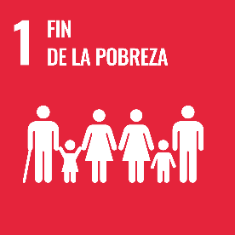
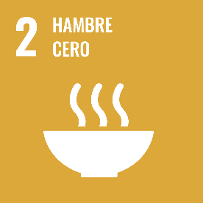
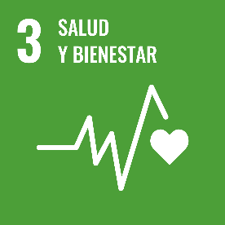
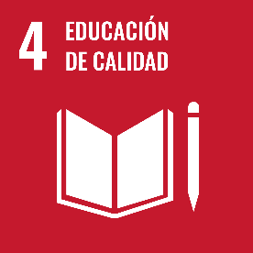
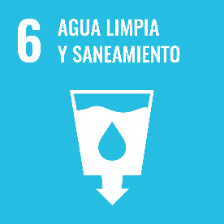
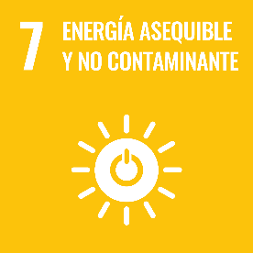
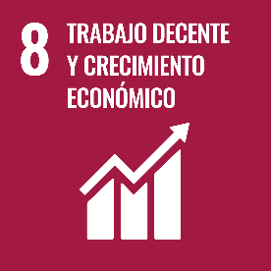
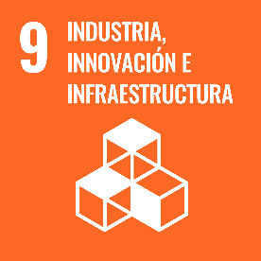
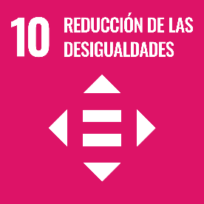
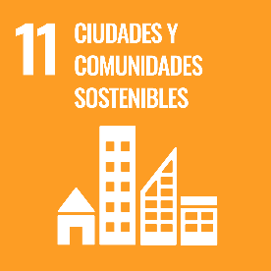
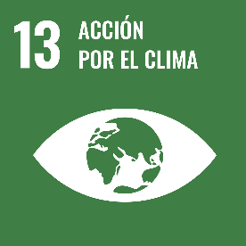
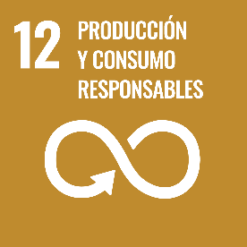
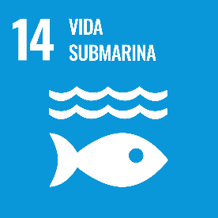
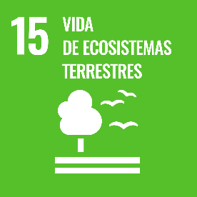
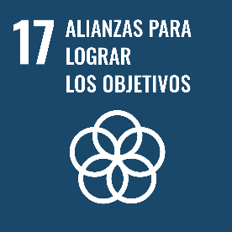
Description of the activity
ACTIVITY IN NUMBERS
# inscriptions: 30
# participants: 30 # badges: 7
# ECTS: 1
# Communities involved: 1
# mobilities: 0
Universities involved: 1
UPM
The Campus Climate Fresk activity was held in March of this year, allowing students from different grades and study areas to learn more about climate change and the measurement of carbon footprint emissions.
The whole activity was carried out in two stages, the first being about knowledge on climate change (online), and the second, on the calculation of the Greenhouse Gas (GHG) emissions and carbon footprint (two face-to-face sessions). The first stage had a playful and participatory character. The attendees were separated into groups led by members of the DISCOVERY Community and guided for the execution of the day. Through cards with images and information, a collage of causes and effects was made, promoting learning and awareness about climate change. At the end, a round of questions was asked about how the participants felt with all this new information, and what changes and/or commitments they believe they can make to generate a real impact and achieve a better future.
The carbon footprint course was conducted by Professor Sergio Alvarez from the Universidad Politécnica de Madrid (UPM), who spoke about greenhouse gases, the carbon footprint, its scope and how to measure them, providing the necessary sources of information and how to make spreadsheets and reports.
The students were mandated to carry out the carbon footprint measurements for scopes 1, 2 and 3 of different UPM’s schools, giving a dissertation at the end of the workshop.
Activity was intended for undergraduate, master's or doctorate students with interest and motivation in climate change and emission calculations. A total of 30 people participated in the activities, of which 23 completed both stages.
SDGs:
Impact: 5

Slide 3
Results
Results of the activity:
Of the 30 registered people, 14 attended Climate Fresk, and 23 people delivered their final carbon footprint calculation report as a product of the seminar.
Assessment method:
Realization of 1 hybrid session of Climate Fresk, 2 face-to-face sessions of the “Carbon Footprint Calculation Workshop” was completed and it concluded with the delivery of a carbon footprint calculation report for each department of the UPM. The reports were made in groups of 2 or 3 people and were presented during the second session to the person in charge of Sustainability of the UPM.

Slide 4
Lessons learned
What we can improve:
Improve the motivation of students to participate in the activity through greater dissemination and explanation of the workshops.
Record the sessions to share on the community's YouTube channel.

Slide 5
Evidences
EELISA:
https://eelisa.eu/events/campus-climate-fresk/
Instagram
https://www.instagram.com/p/CeiW54LLPtI/
https://www.instagram.com/p/CeN2YlejBDc/

Slide 6
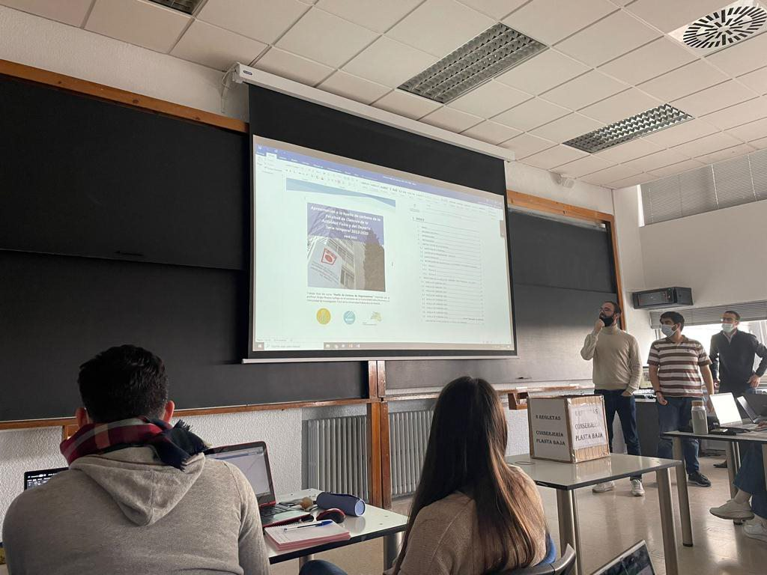
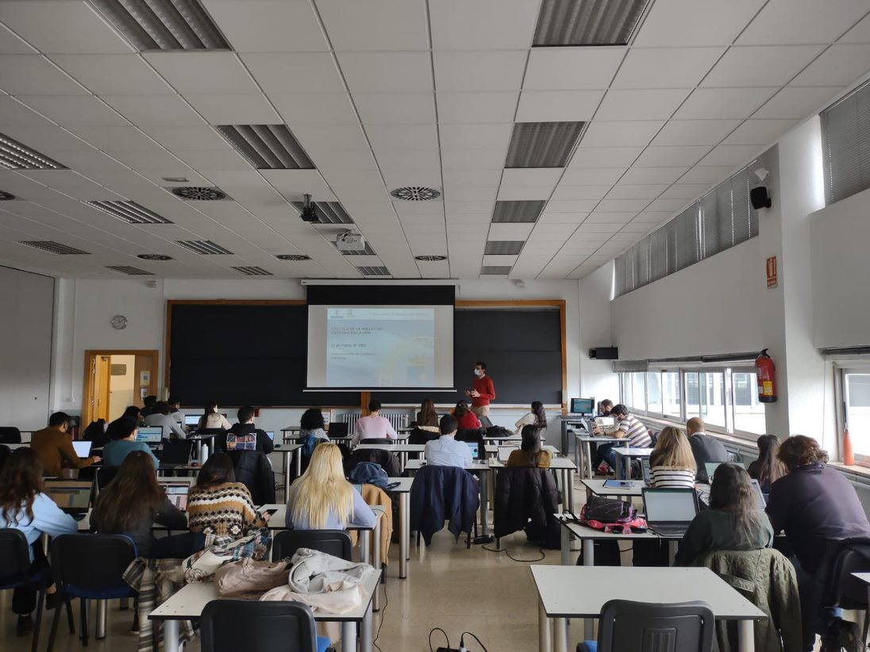
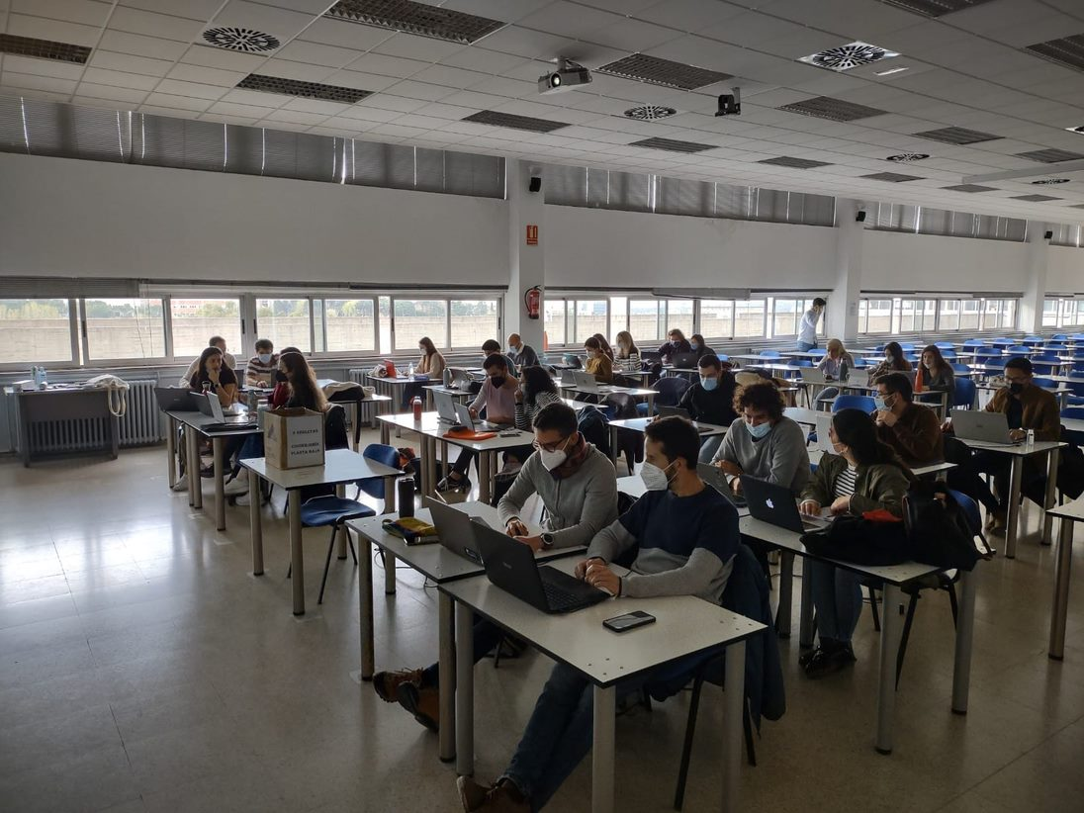
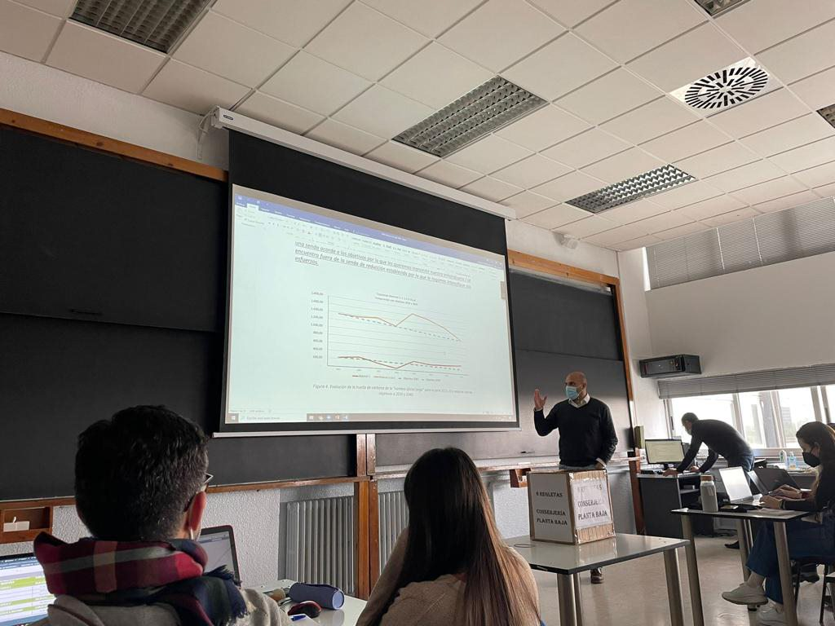
Evidences

Slide 7
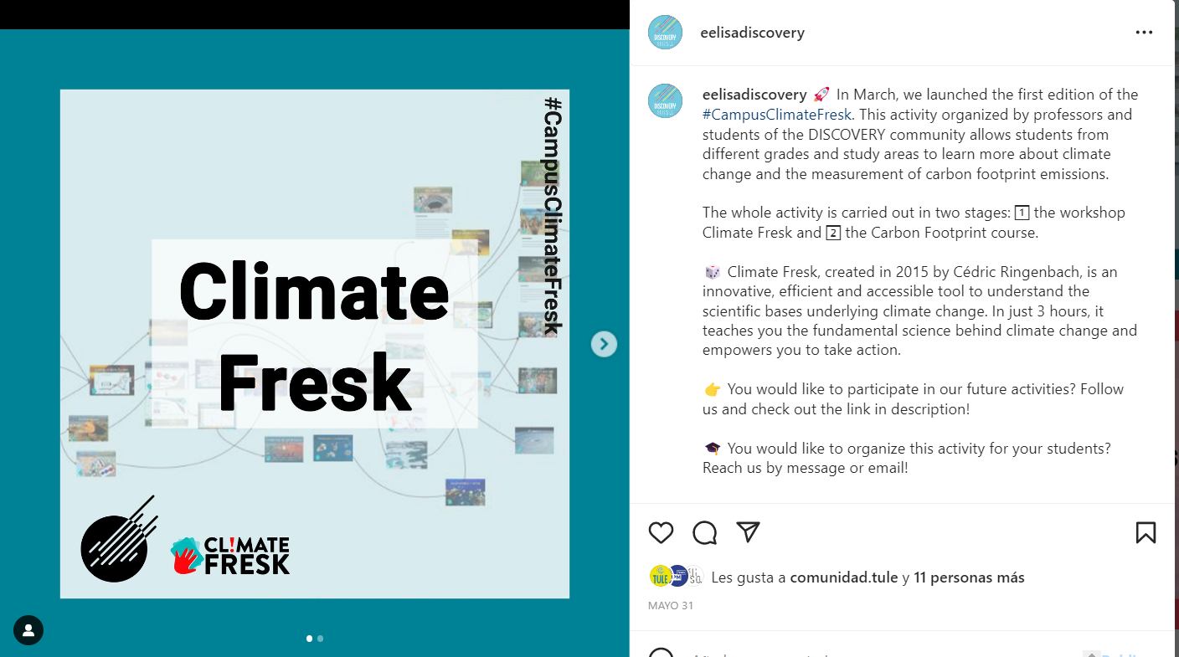
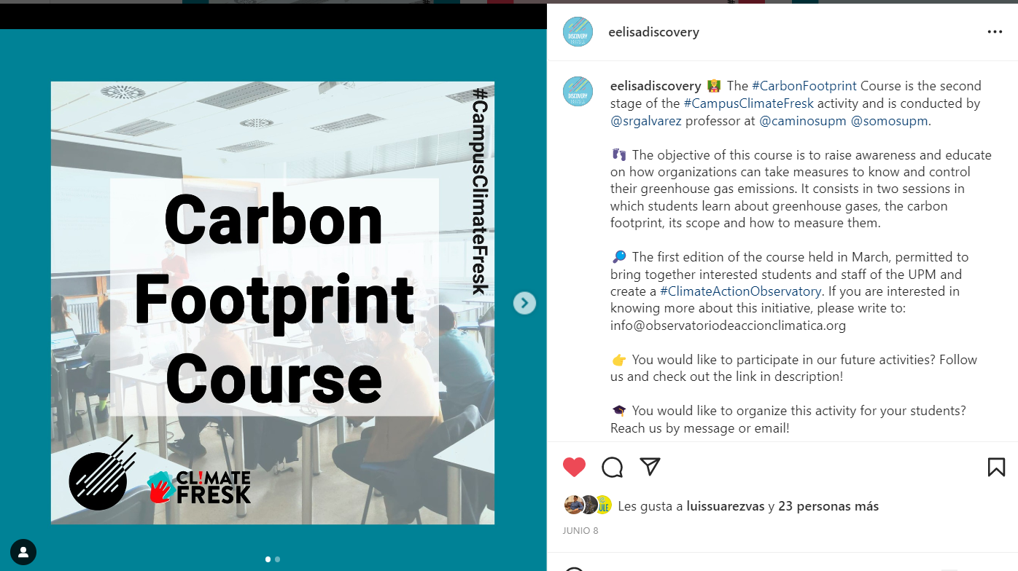
Evidences
Instagram post
Instagram post

Slide 8
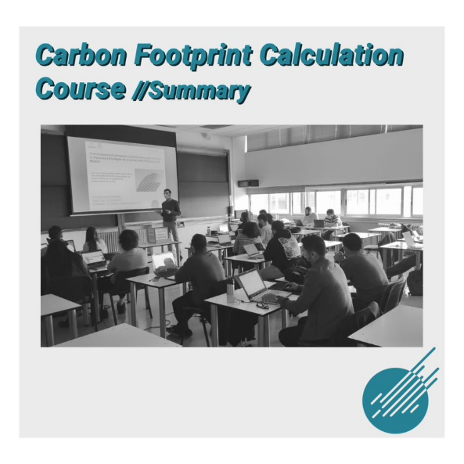
Evidences

Slide 9
Disclaimer
EELISA IS

