Slide 1
EELISA ACTIVITY
1st Danosa Sustainable Comfort Contest.
Date of the activity: Nov ’21 – May ‘22
Organized by: DISCOVERY UPM
Sponsors/other stakeholders:
DANOSA
UPM
Location: UPM and DANOSA’’s Office
Format: Face to face

Slide 2
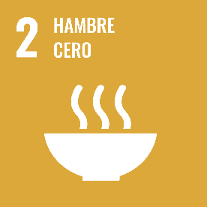
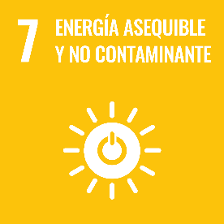
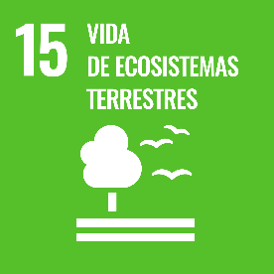
Description of the activity
ACTIVITY IN NUMBERS
# inscriptions: 21
# participants: 11 # badges: 11
# ECTS: 1
# Communities involved: 1
# mobilities: 0
Universities involved:
UPM
The 1st Danosa Student Contest set as its objective the improvement in thermal efficiency of a building on the UPM Campus, based on the DANOTHERM SATE systems.
The projects had to provide, through the rehabilitation of the building on the outside (and inside), sufficient thermal and acoustic comfort to justify the possible investment.
Buildings belonging to Cultural Heritage: an aspect similar to the original must be maintained in those buildings belonging to cultural heritage.
The contest prizes consisted of:
•1st prize: 2,000€ and the possibility of obtaining a work scholarship for its members in the Danosa Technical Department (previous approval from the Danosa HR department and under the UPM company internship program)
•2nd prize: 1,000€
•3rd prize: 750€
•Extraordinary innovation prize: €500
The winner of the 1st prize & Innovation prize were the members of team number 10 (012022G10). The participants were Martina Dell Unto and Juan Pablo Cote Cortés, both from the UPM Master in Environment and Bioclimatic Architecture (MAYAB).
Activity started on November 10, 2021, with a talk talk on Sustainability and Energy Rehabilitation held by DANOSA staff, and concluded on May 6, 2022, with the presentation of the projects.
SDGs:
Impact: 5

Slide 3
Results
Results of the activity
10 working groups were registered, integrated by 21 students from different universities and degrees.
5 groups submitted proposals for the contest, resulting in the 3 winning groups.
Assessment method
Working hours required of the participants: 9 hours of seminar + 21 hours of teamwork
Project valuation weights:
Architecture (50%): The design of the design itself, the technical solution to improve the envelope, as well as the sustainability of the project in its economic, ecological and social context will be valued positively.
Quality of construction details (25%): Quality and consistency, as well as all the criteria and technical considerations to resolve all the unique points and comply with the legal requirements contained in the CTE.
Use of DANOSA products (25%): Correct use of the products of the DANOTHERM SATE system and other systems available from DANOSA.
Innovation (10% extra): Innovative proposal on the existing systems that allows adding new functionalities, as well as improving the technical features of the DANOSA systems.

Slide 4
Lessons learned
What we can improve:
Improve time for sending information to participants.
Greater dissemination of the event.

Slide 5
Evidences
Contest website:
https://www.concursodanosa.com/
Other publications:
https://dat.etsit.upm.es/2022/02/26/concurso-danosa-para-estudiantes/
https://blogs.upm.es/actividadesacreditables/concurso-confort-sostenible-danosa-c31108/

Slide 6
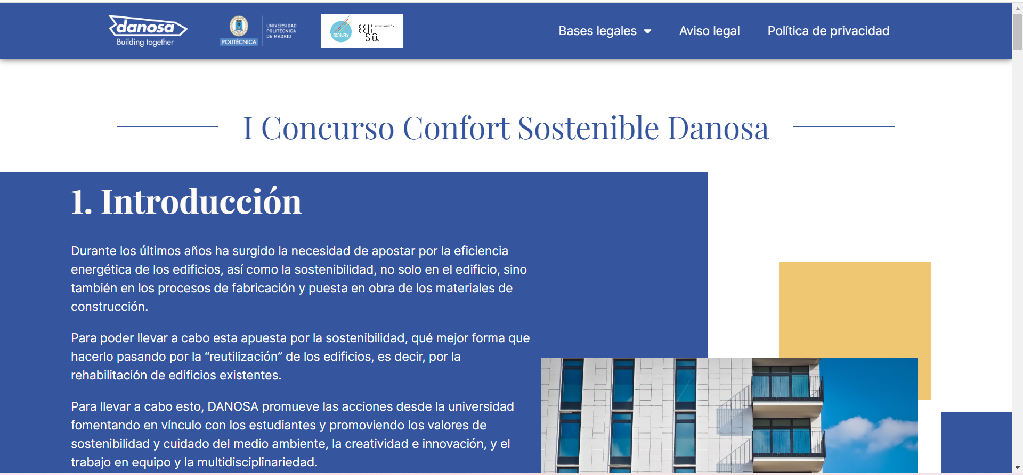
Evidences
Contest website

Slide 7
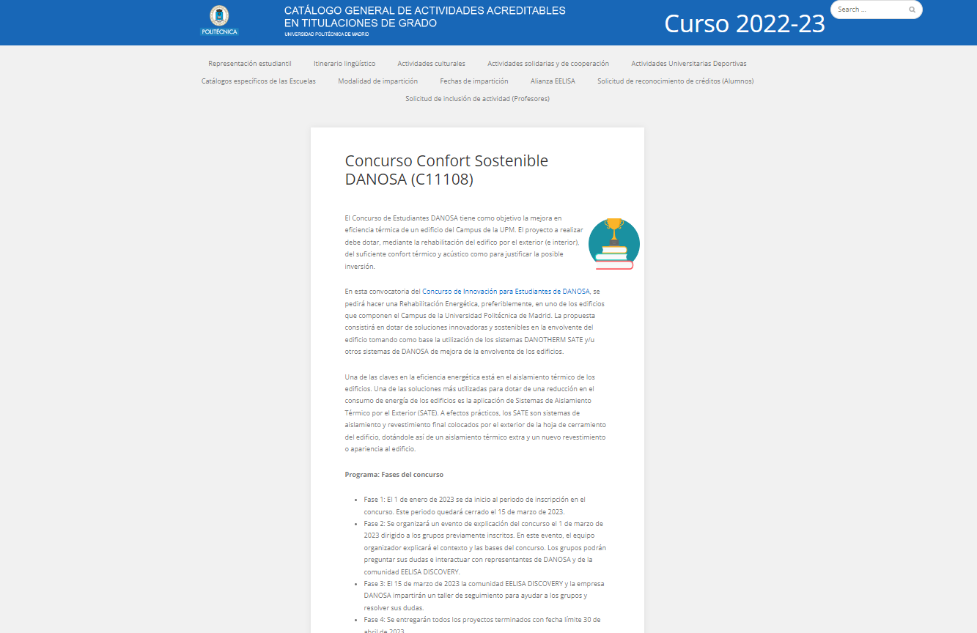
Evidences
Online publication of “General catalog of accreditable activities in undergraduate degrees”
Online publication of the Delegation of Telecommunications students website

Slide 8
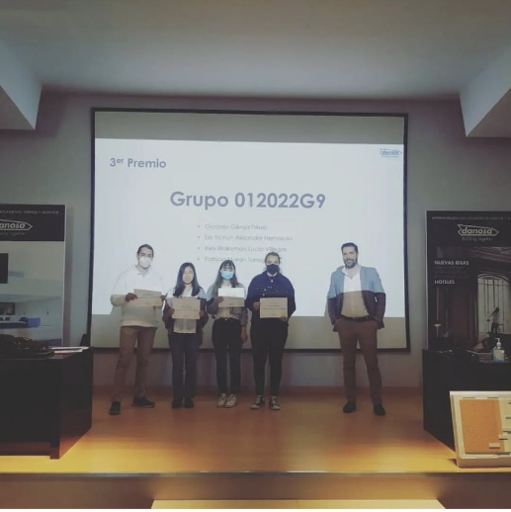
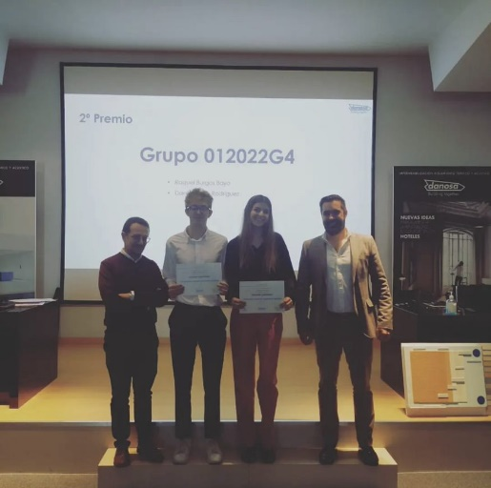
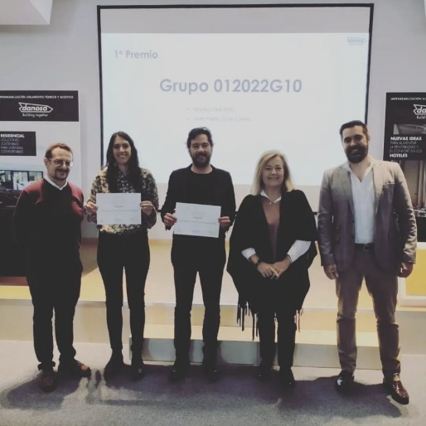
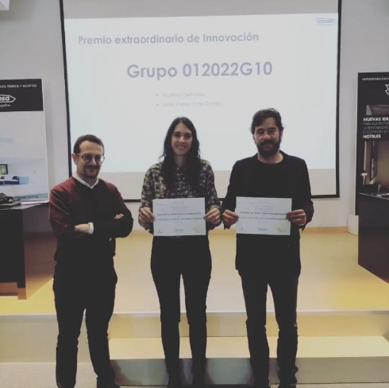
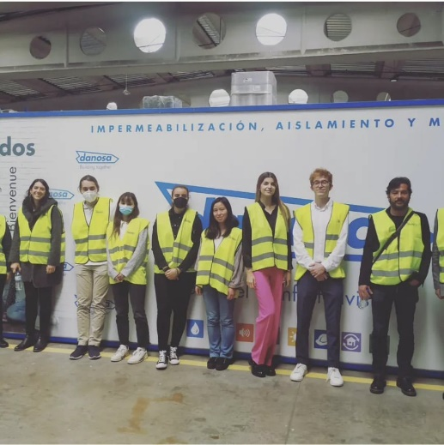
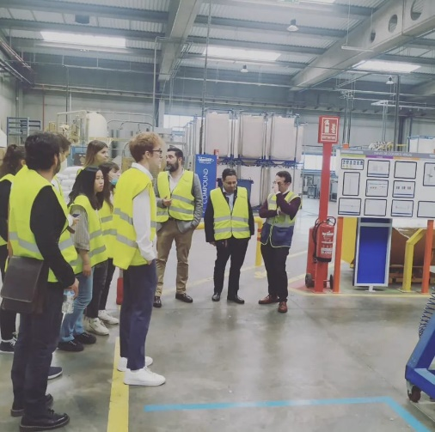
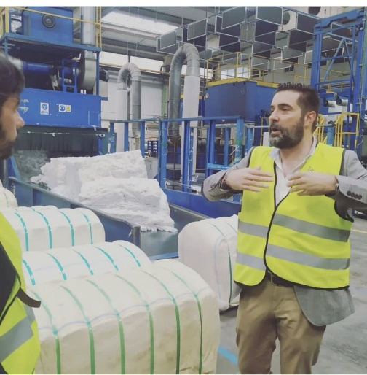
Evidences

Slide 9
Disclaimer
EELISA IS

