Slide 1
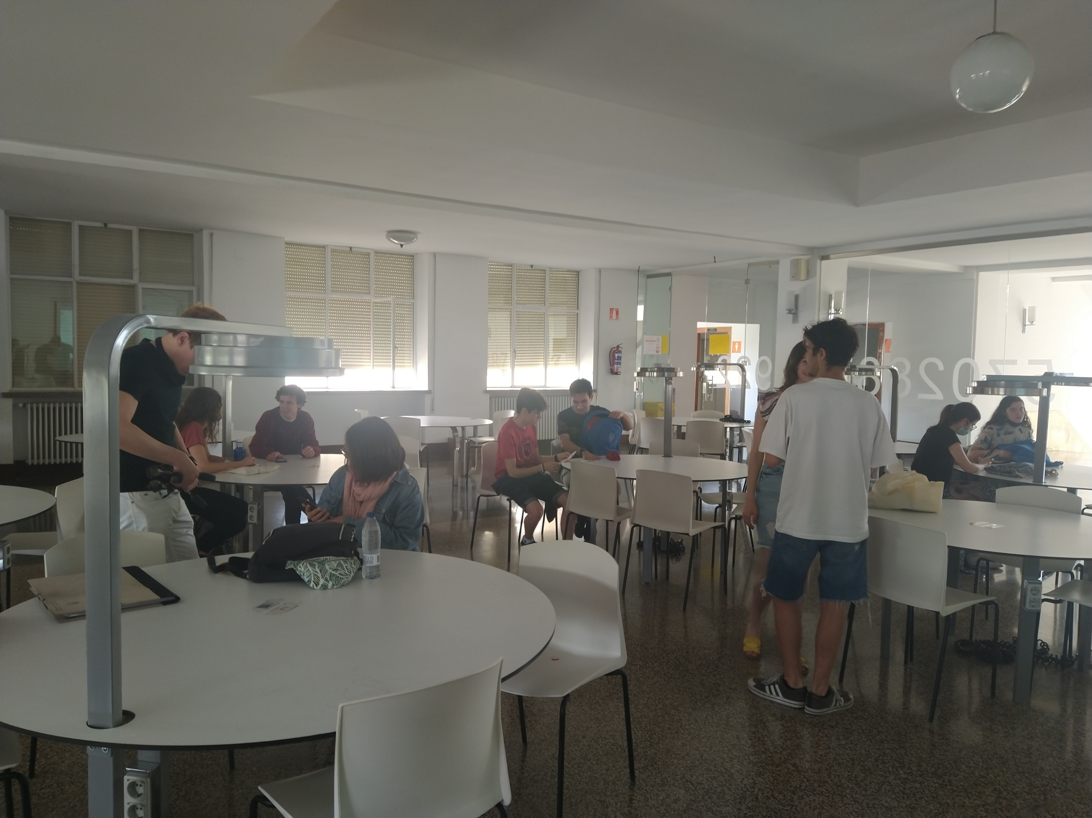
EELISA ACTIVITY
Students Eelisa co-design workshop
Co-design of EELISA future activities with students
Date of the activity:24/05/2022
Organized by: SUSBCC EELISA COMMUNITY.
Prof. Sergio Vega, Prof. Beatriz Arranz, Prof. Carmen Sánchez Guevara, Prof. Patricia Hernández Lamas.
Location: Madrid
Format: Face-to-Face

Slide 2
Description of the activity
ACTIVITY IN NUMBERS
# inscriptions: 19
# participants: 19 # badges: 19
# ECTS: 0
# Communities involved: SUSBCC
# mobilities: 0
Universities involved: (UPM)
A team of professors of the UPM Technical School of Architecture of Madrid, briefly presented Eelisa and SUSBCC Community to the students. Some of the activities already carried out were included.
After the introduction the students were invited to think about the future challenges and how EElisa can address them.
Then the suggestion of future activities were also demanded.
SDGs:
Impact: "4-C-5"; "4-S-1"

Slide 3
Results
The students delved into what EElisa is, its mission, vision and objectives.
Students got to know the SUSBCC EElisa community, its mission, vision and goals.
The students participated in a co-design workshop on the future of EElisa
Suggestions from the students on how to improve the visibility of EElisa.
Suggestions from students on how to ENCOURAGE STUDENT PARTICIPATION.
Assessment method
Participation

Slide 4
Lessons learned [in one page]
What’s work out
The objective was to involve the students in the future of Elisa and listen to their interests and expectations. This involvement has two benefits: knowing their points of view, obtaining information and making them aware of the interest of being part of EElisa.
What we can improve.
The number of students can be higher.
There were students only from the School of architecture (UPM).
A similar workshop with international students and with interdisciplinar participation would be more powerfull.

Slide 5
Evidences
Workshop Poster / Social media pre-post difusión.
Images of the ACTIVITY.
Images of the ideas produced.

Slide 6
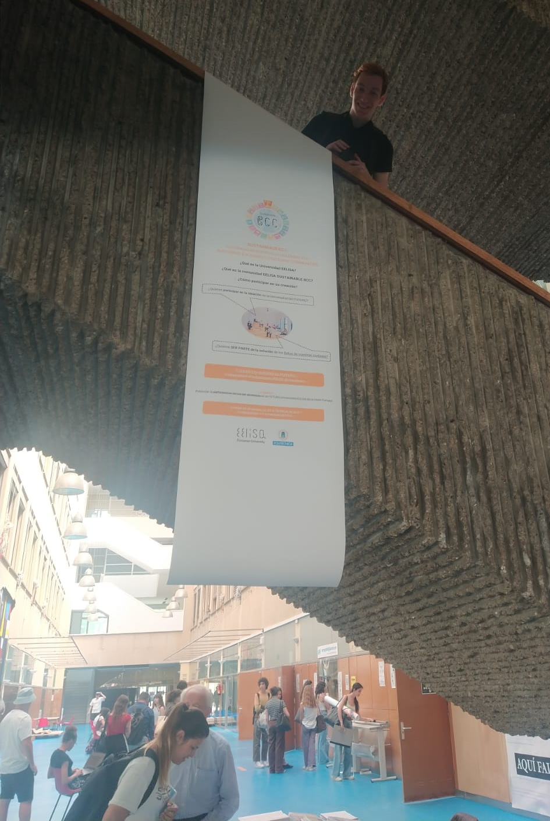
Evidences

Slide 7
Evidences

Slide 8
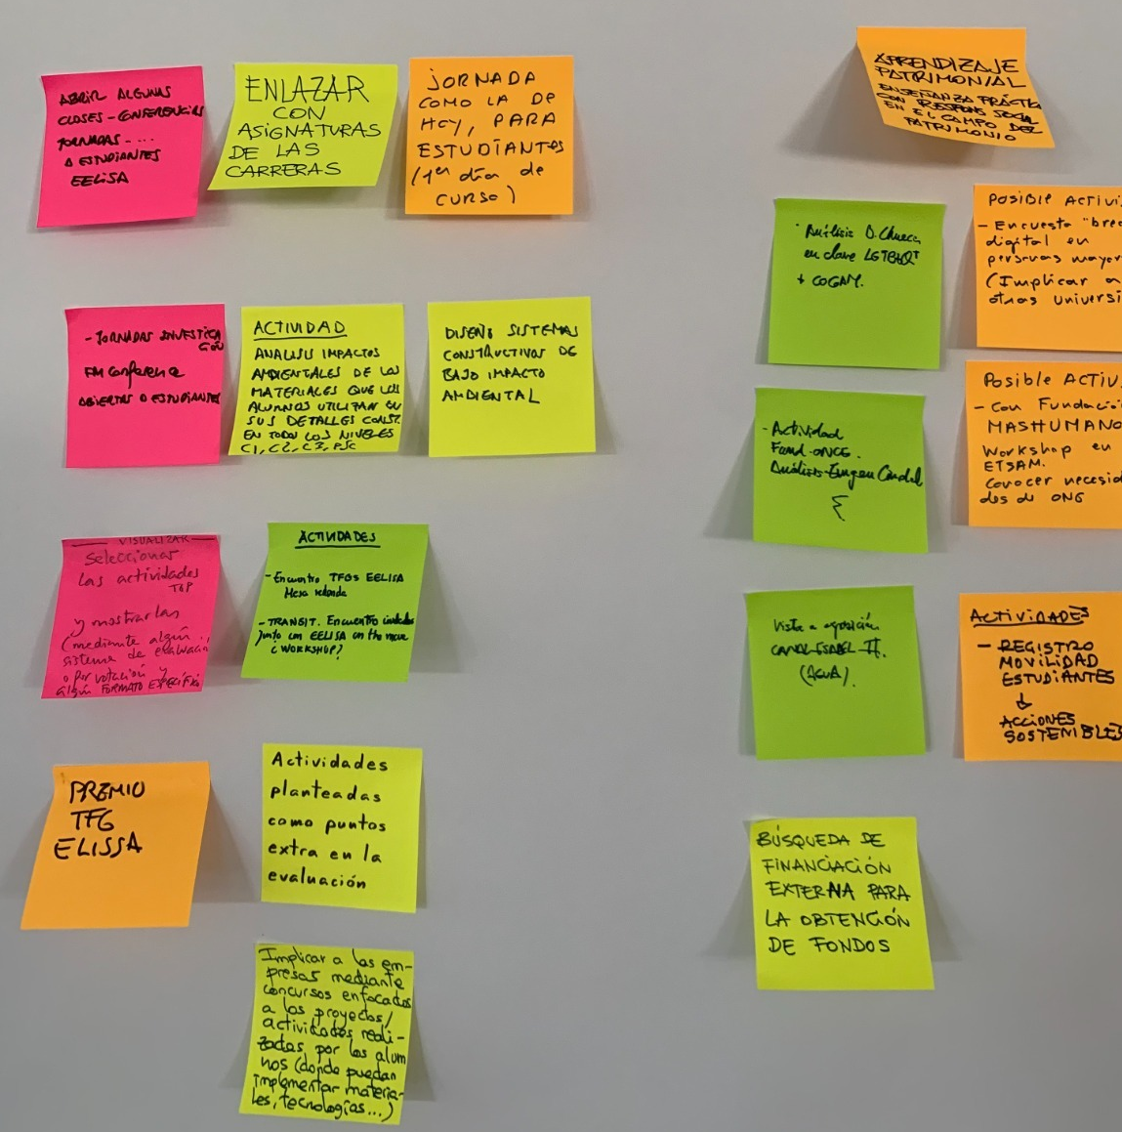
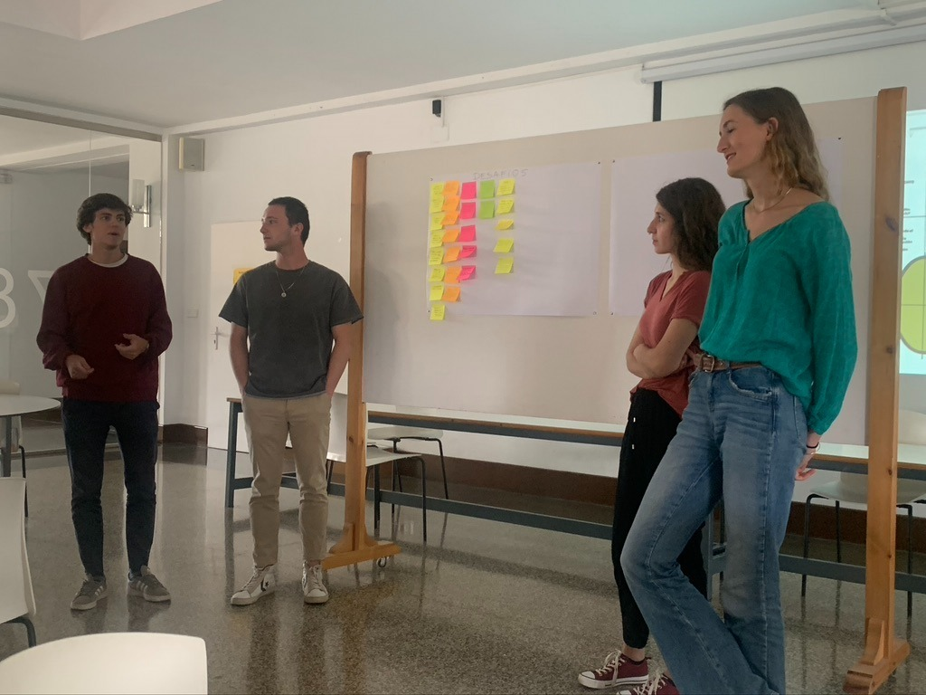
Evidences

Slide 9
Disclaimer
EELISA IS

