Slide 1
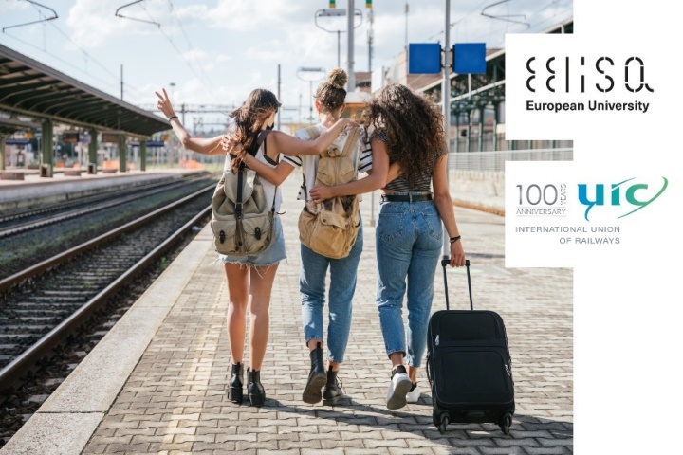
EELISA ACTIVITY
Image of the activity
The cool rail project.
Date of the activity: from July to November 2022
Organized by: UPM, UIC, UGE-ENPC
Sponsors/other stakeholders:
Location: Paris, Madrid, Bilbao
Format: (Face-to-Face/online/hybrid)

Slide 2
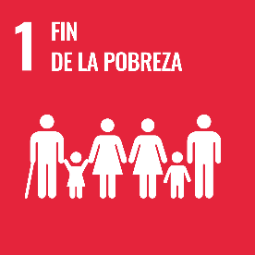
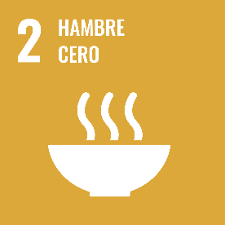
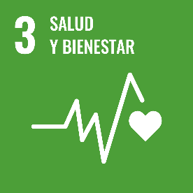
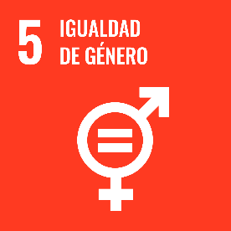
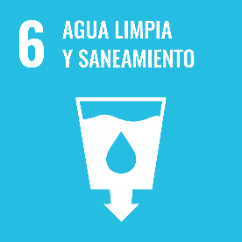
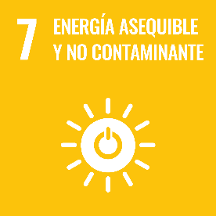
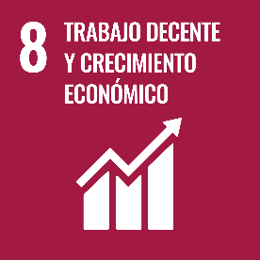
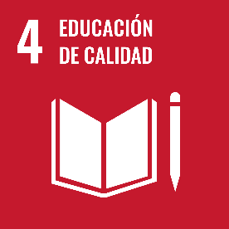
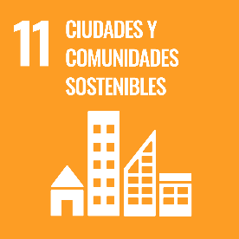
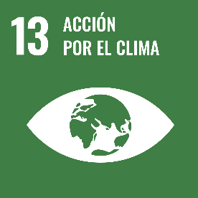
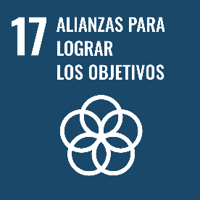
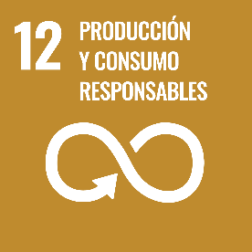
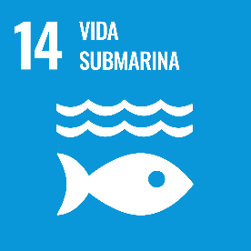
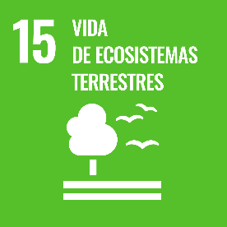
Description of the activity
ACTIVITY IN NUMBERS
# participants: more than 214 # badges: 3
# ECTS: 0
# Communities involved: HEAR
# mobilities: 5
Universities involved: UPM, UGE-ENPC
The main activity of the Cool Rail Project has been an idea contests in the framework of the European Youth Year, It has been developed in two phases: the first one with Civil Engineering Master Degree Students from UPM (54 participants), and the second one open to any person. In this last phase, 99 responses from 16 countries have been received.
Also, a video contest was launched, for young travellers from 15 to 29 years old who had to send an original 2-minute video about why railways are cool. A total of 31 videos and 412 votes were received.
The Cool Rail Project held two workshops aimed at the participation of the general public, previously targeted by surveys, with professionals and technicians of the sector. They allow to consolidate the qualitative results and contrast them with the state of the art from an interdisciplinary and intergenerational perspective.
In the Design Thinking activity 30 participants were distributed in five working groups composed equally between students, academics, professionals and technicians of the sector. The activity orbited around 5 working tables where each group had to go through 5 different steps. Each table represented a railway customer assumed by the coordinator, who presented the group with a problem to solve in order to improve the satisfaction of the role assumed. Activity's essence consisted of each group building new solutions on the work produced by the previous groups in each of the tables for each of the roles.
SDGs:

Slide 3
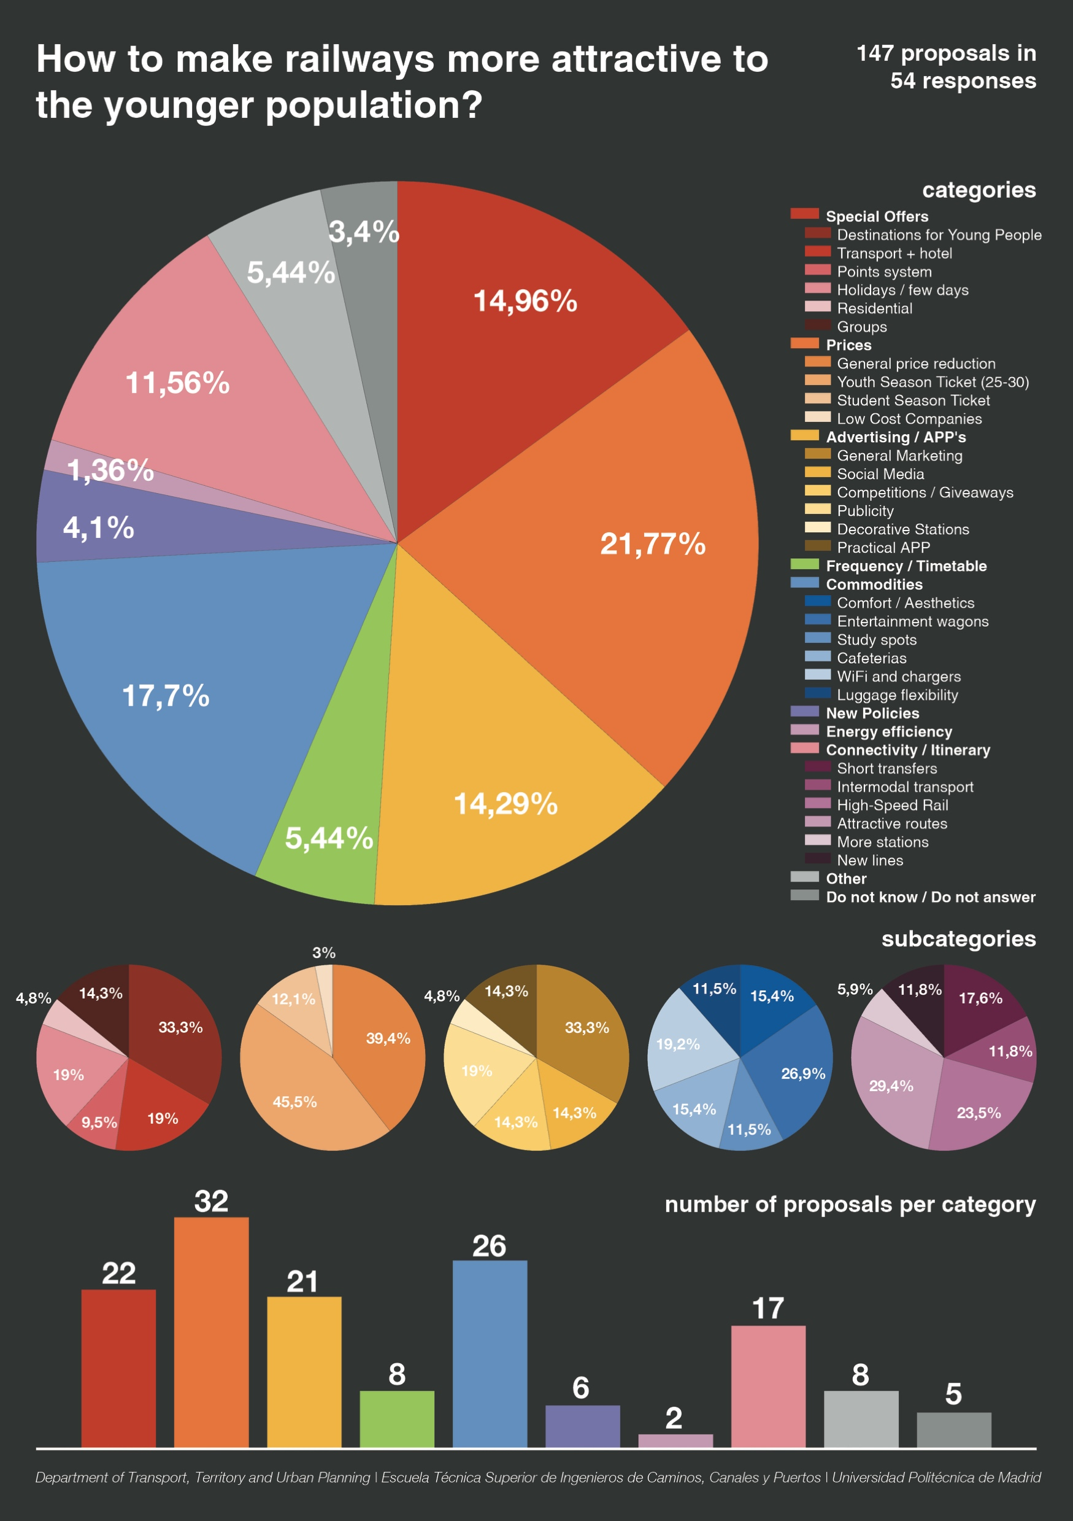
Results
Idea contest: 153 participants from 16 countries
Video contest: 31 videos and 412 votes.
2 workshops
Design Thinking: 30 participants
Assessment method: surveys

Slide 4
Lessons learned [in one page]
Contests with atractive awards
Channels of dissemination in the EELISA context.

Slide 5
Evidences
https://uic.org/events/the-cool-rail-project

Slide 6
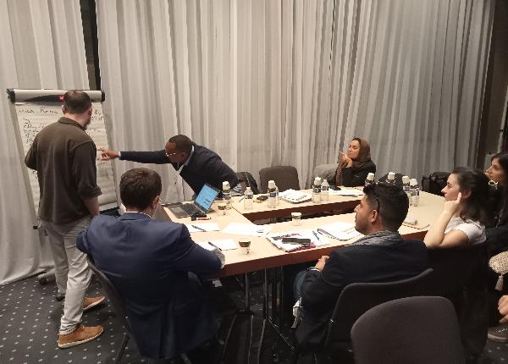
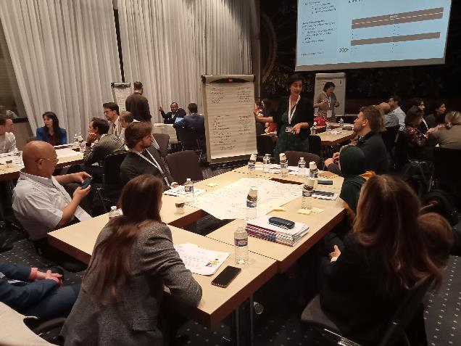
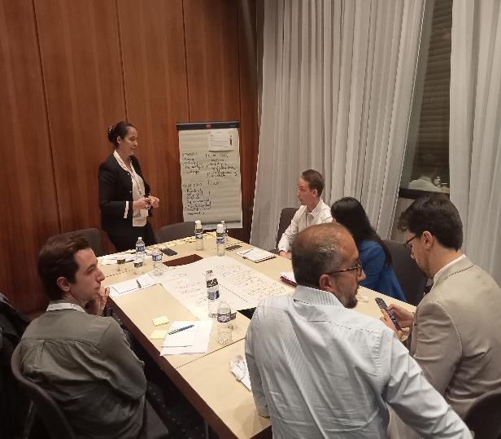
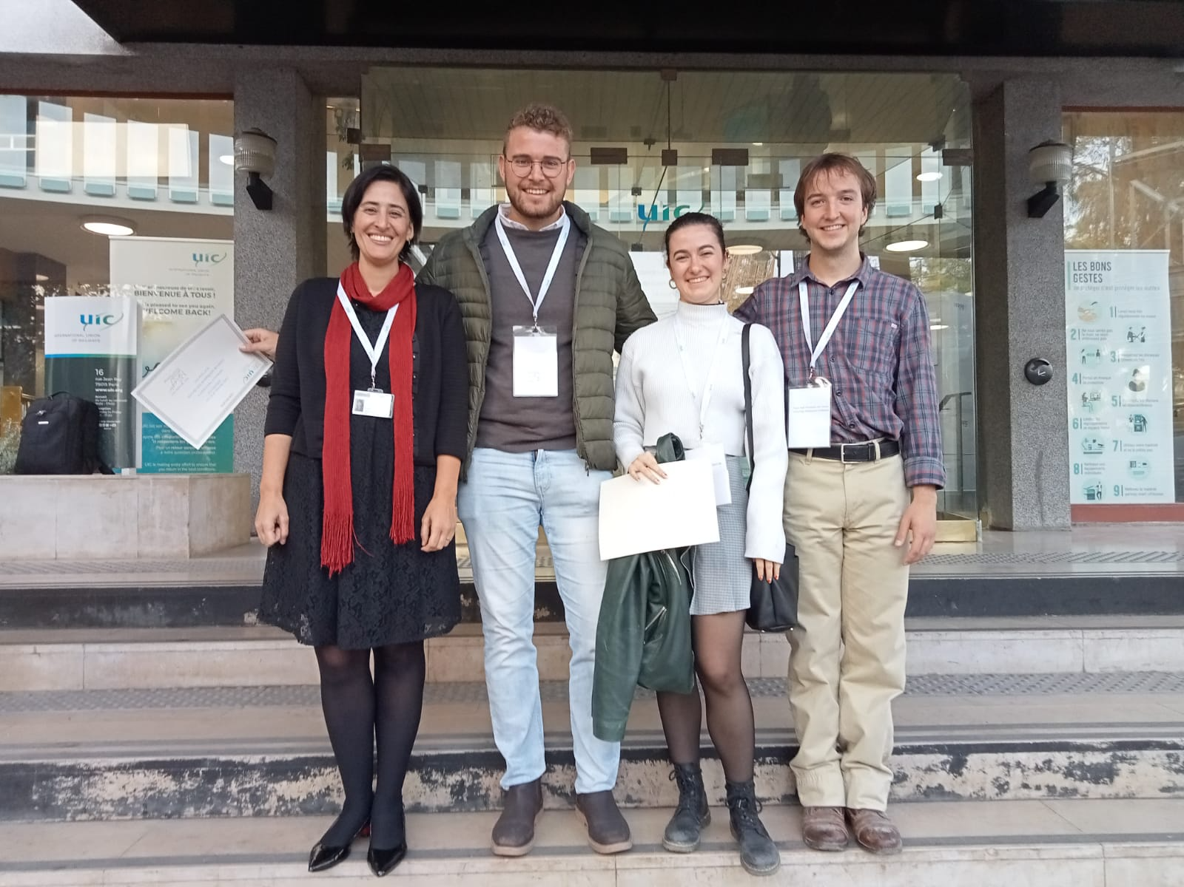
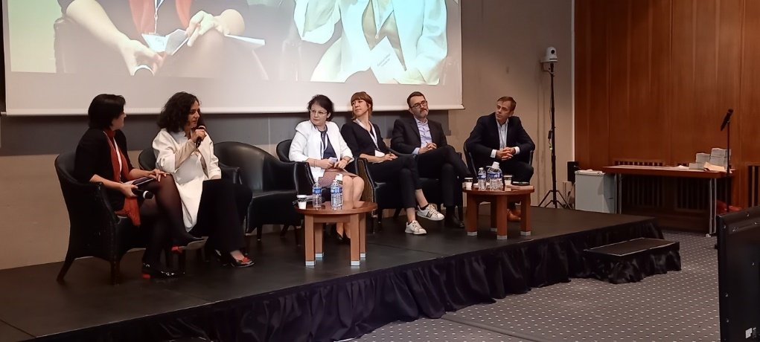
Evidences

Slide 7
Disclaimer
EELISA IS

