Slide 1
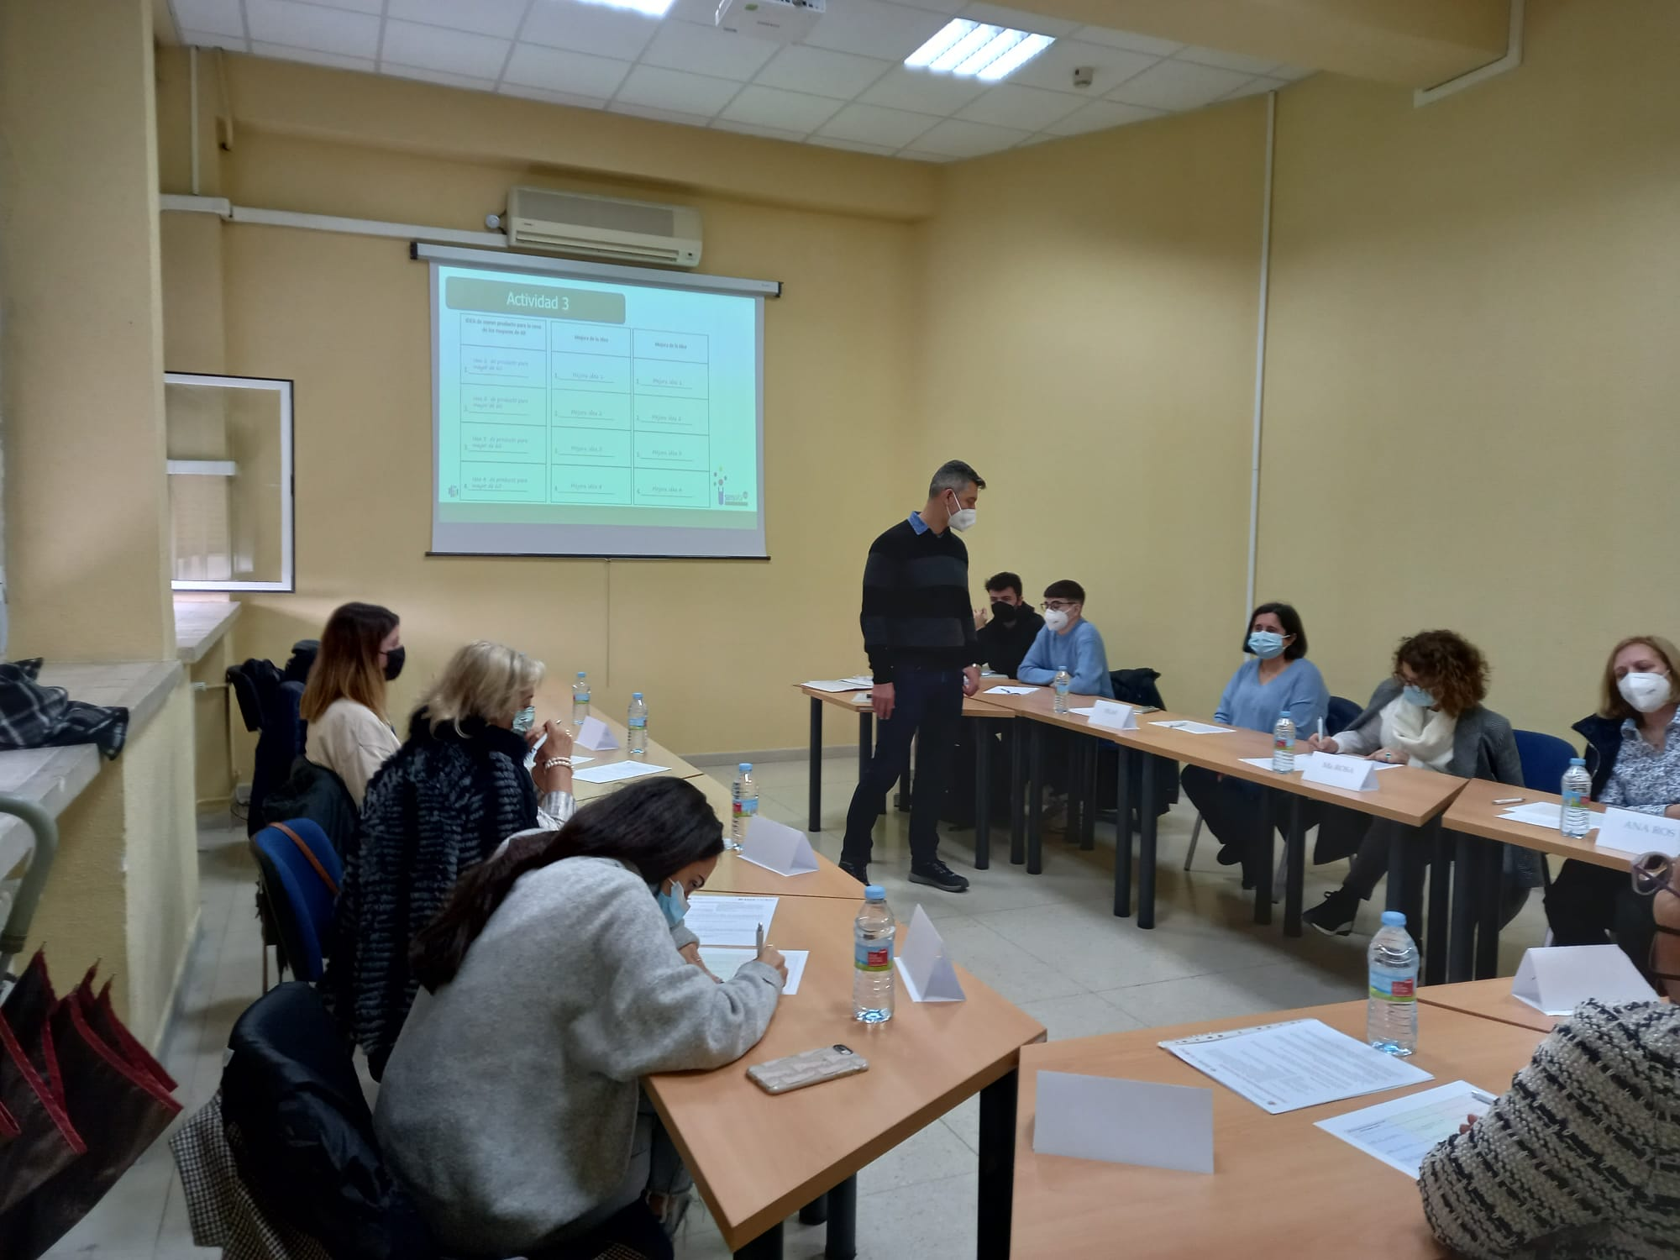
EELISA ACTIVITY
Image of the activity
Co-creation of new concepts of sustainable food taking into account the voice of consumers
Date of the activity: 14 – 18 March, 2022
Organized by: Carolina Chaya Romero
Sponsors/other stakeholders: No
Location: Meeting room of EUITA for co-creation sessions.
Online meetings for organization and analysis of co-creation sessions
Format: Hybrid

Slide 2
Description of the activity
ACTIVITY IN NUMBERS
# inscriptions: 16
# participants: 5 # badges: 0
# ECTS: 1
# Communities involved: Green Planet
# mobilities: none
Universities involved: UPM
Co-creation with consumers guides new concept and product developments by including them in the qualitative research. Senior naïve consumers were invited to join the sessions together with food scientists, sensometricians and industrial partners.
The activities applied during the session were carefully designed with the aim of enhancing creativity. Sessions had a duration of 1,5 hours and each participant was asked to attend two sessions.
24 consumers were involved.
SDGs:

Slide 3
Results
Results of the activity in one page: Scolarship assistants (Master students) involved in the organization of these activities learnt how to deal with this kind of co-creation sessions. The leadership of the sessions was always done by Dr. Carolina Chaya and Dr. Diego Torres, visiting scholar from IATA (CSIC). But the students participated in the organization and transcription of the sessions and were also involved in the analysis of the results.
Assessment method: Attendance and written results.

Slide 4
Lessons learned
What’s work out:
With the participation of 24 consumers and 4 professionals from the distribution and food industry. It was a wonderful learning experience for the scholarship team from last year.
What we can improve:
This activity is part of a project and therefore cannot be repeated, maybe there should have been a planned continuity.
Also participation could be bigger.

Slide 5
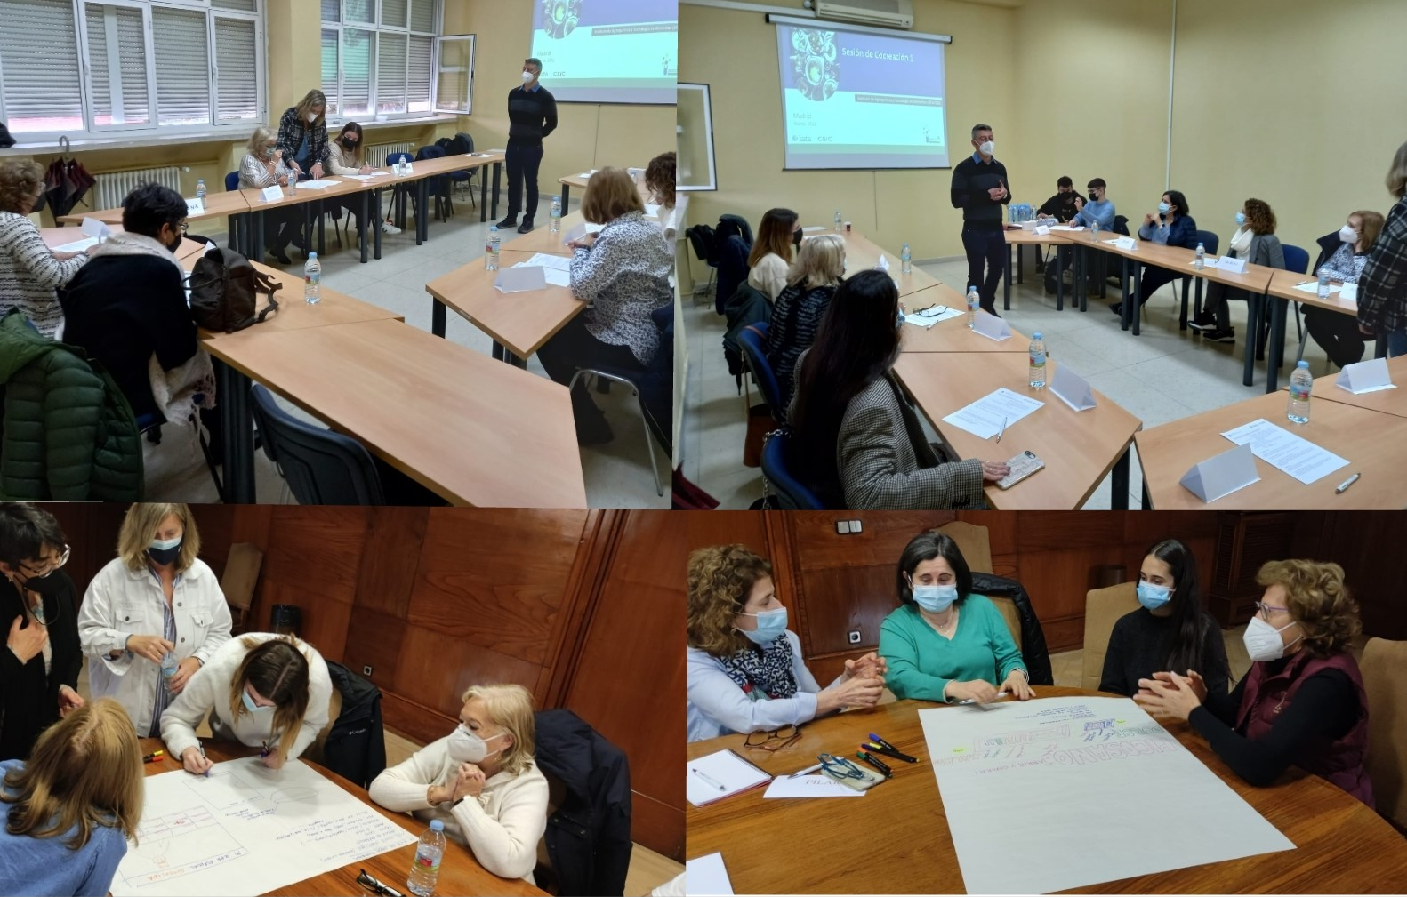
Evidences:

Slide 6
Disclaimer
EELISA IS

